Slide 1

KNYPERSLEY FIRST SCHOOL
Welcome to Reception
2026

Slide 2



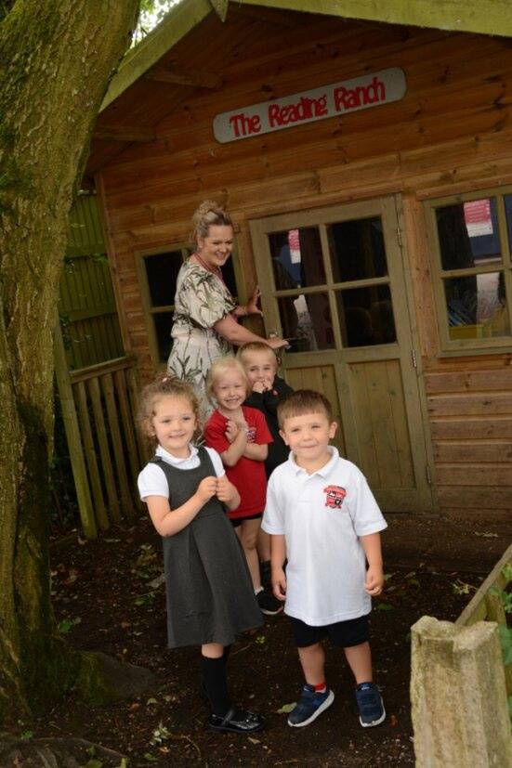





What We'll Discuss today
  School website
  Calendar Dates and Support
  Communication
  Attendance
  Behaviour Policy and Rewards
  SEND support
  Year Group Specific Overview
  Weekly Timetable
  PTFA

Slide 3





Children First Learning partnership
https://cflptrust.co.uk/

Slide 4



School Website
http://knypersley.staffs.sch.uk/
Policies
Newsletter - Online/ via Arbor (paper copies available via the school office).
Safeguarding page
PTFA information
School Calendar
Everything you need to know is on our website!

Slide 5

Calendar Dates
In September we will share ‘Important Dates for Parents’ overview this document captures all key dates that we have planned into the diary already to help you prepare for the year ahead. We will also share a Non-uniform overview that can be used to again aid your calendar and organisation.
Currently on the school website under calendar there are the school dates to aid you in your holiday booking and child care needs. Please pay close attention to inset days as they have been adjusted this year.
We do use Facebook, Arbor and the newsletter as reminders and to indicate any changes but please ensure you add the information as it is given as to not rely on reminders and to aid organisation and timeframes.
Please share:
School calendar
Important Dates example
Non-uniform overview as example
26-27 term dates
All can be found on:
https://knypersley.staffs.sch.uk/calendar/

Slide 6



Communication
We value your communication and feel that it is important that everyone feels heard and valued within our school community.
Below is an outline our the channels of communication within our school:
Arbor
Weekly Drop-in
Arbor is our main platform for direct communication for staff and parents. Arbor messages are check before school and after school by staff between the hours of 8:30-5:30pm. Mrs Taylor in the office checks Arbor frequently throughout the day. Please use Arbor for non-urgent messages, clubs and parent’s evening appointments.
Beyond the formal parents meeting events noted above, our school has always offered a night during every school week where staff are available to answer any questions you may have or to address any concerns which may have arisen. These sessions are between 3.30- 4p.m
Reception drop-in will be on a Thursday
Main Office
Reports/ Parents Evenings.
Please call the school office 01782 973810 to pass on urgent time limted messages for example-informing us that your child is absent, booking your child into Kid Zone (due to an emergency). Please be mindful that this is NOT for non-urgent messages that could be passed on by staff at the door.
Reports are sent three times a year at the end of every term. Parent’s Evenings are then run twice a year at the end of Autumn and Spring half terms in order for staff to inform you of successes and next steps.
Parent’s evenings can be booked via Arbor.
Notes:
Newsletter

Slide 7





  Evidence me
We use ‘Evidence’ Me as a form of assessment.

Slide 8
Drop off/ collection
Please drop off your child at 8:45am at Reception door.
End of day is 3:10pm.
Collect from the class doors.

Slide 9

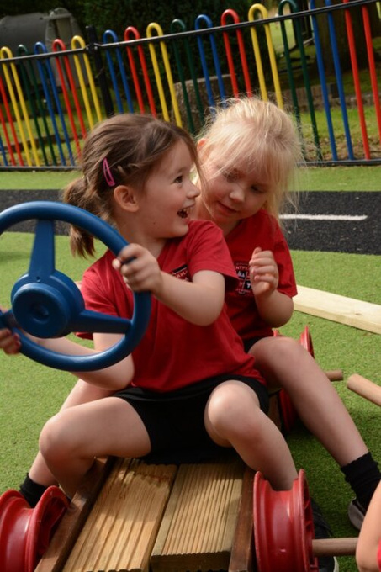


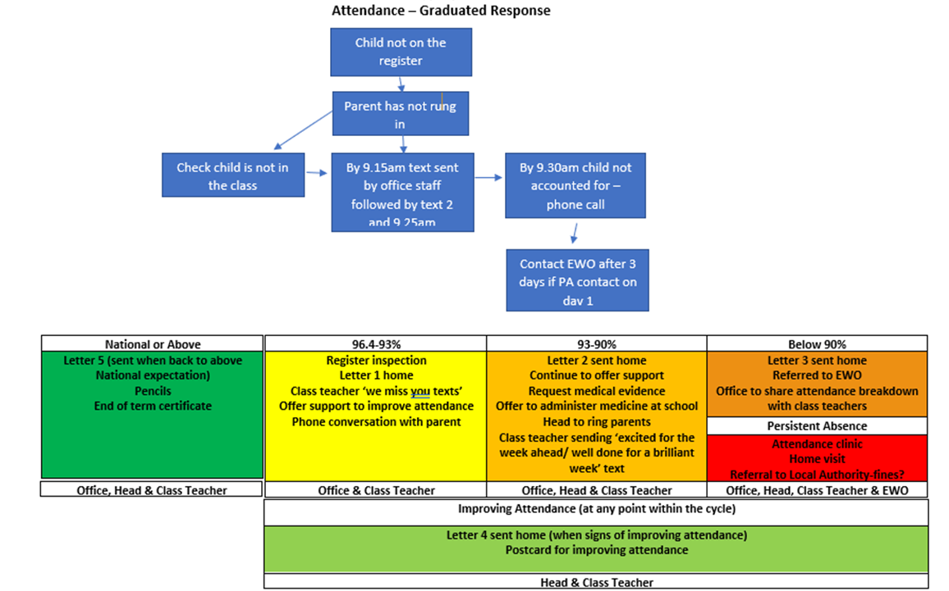



Attendance
Attendance is tracked daily
It is of the up-most importance that you report absences. This is to support our safeguarding procedures
Forming good habits
Supports progress
Increased wellbeing
Supports to build friendships
Holiday request forms can be collected from the school office. We encourage you to avoid taking holidays within school time.

Slide 10
Attendance support
Support for attendance can be given through a range of channels:
Class teacher drop-in for support with adjustments to support morning arrival.
Attendance clinics – Headteacher/ Attendance Officer/ Classteacher / SEND where required.
Please call at any time to arrange a meeting – share briefly your concerns and a member of staff will return your call to offer support and guidance.
Early intervention and working together is key to supporting attendance.

Slide 11
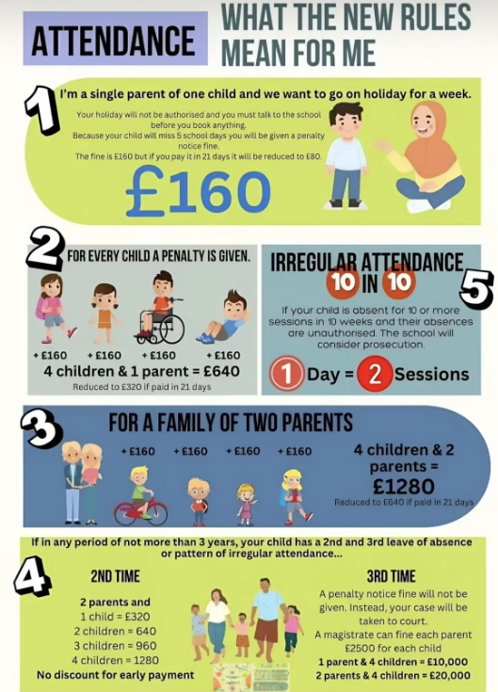
Attendance
Forming good habits
Supports progress
Increased wellbeing
Supports to build friendships
Notes:
CL

Slide 12




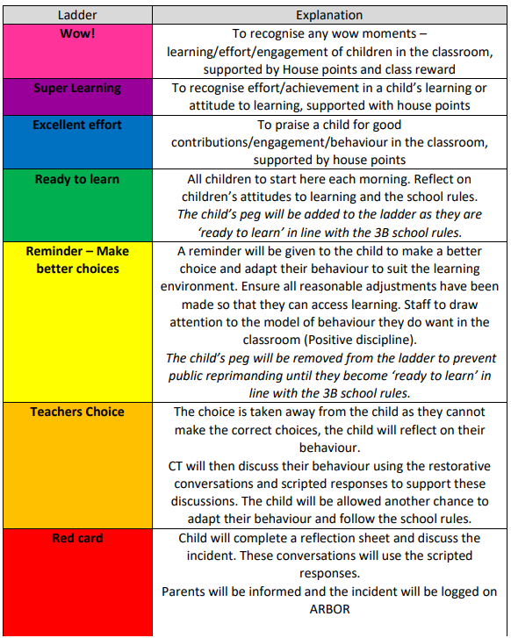

Positive behaviour management
https://knypersley.staffs.sch.uk/wp-content/uploads/2025/07/Knypersley-Positive-Behaviour-Policy-25-1.pdf
Our 3B rules are consistent from nursery to Year 4 which supports children in understanding expectations for behaviour.
Each class starts the year by writing their own class 3B expectations which develop over the years as they do themselves.
Our Positive Behaviour Policy is based upon restorative conversations and practice. Ensuring all children use mistakes as a chance to learn and better themselves.
Parents are notified if their child reaches a ‘red card’. This will mean that your child has needed multiple reminders and have not been able to follow the 3Bs over a period of time.
If your child reaches ‘WOW’ this is down to them following the 3B expectations consistently enough to reach a reward. Moving to WOW is not done due to a one off event or learning achievement.

Slide 13

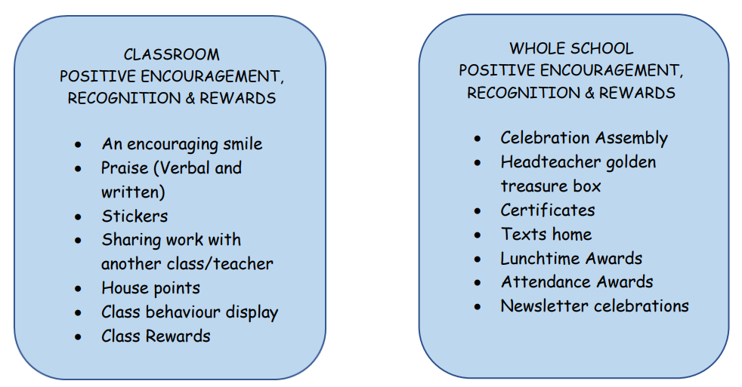
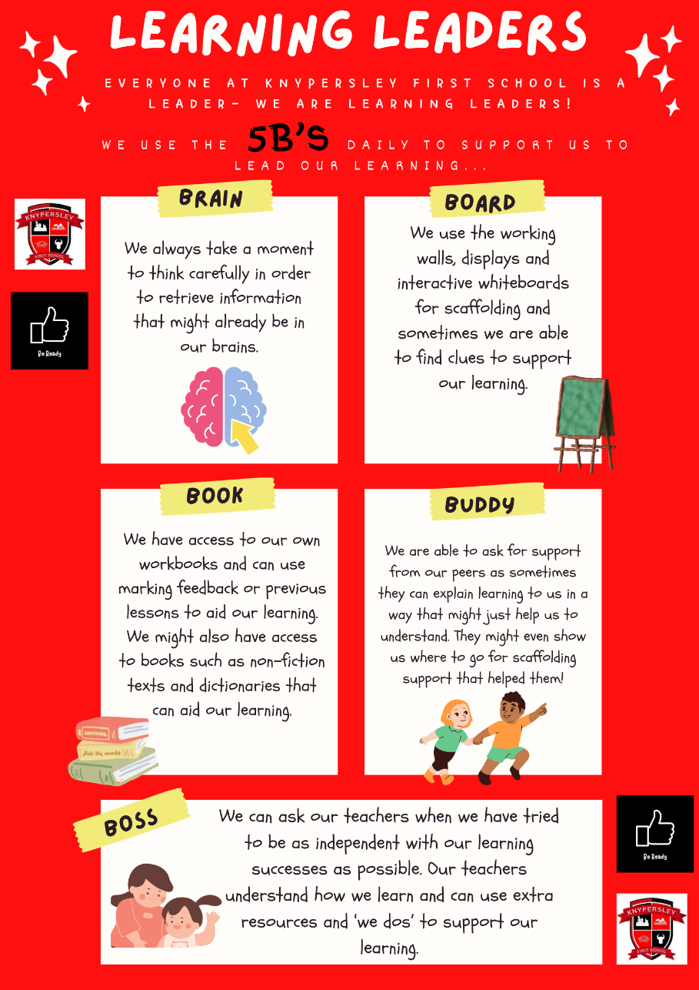
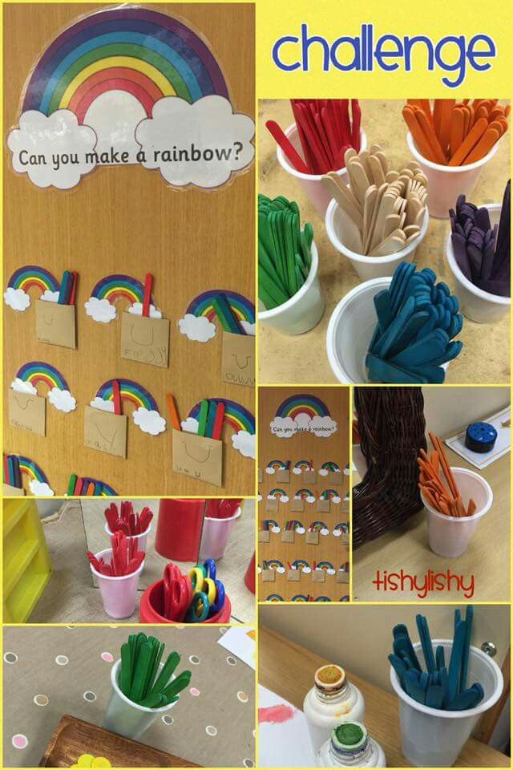
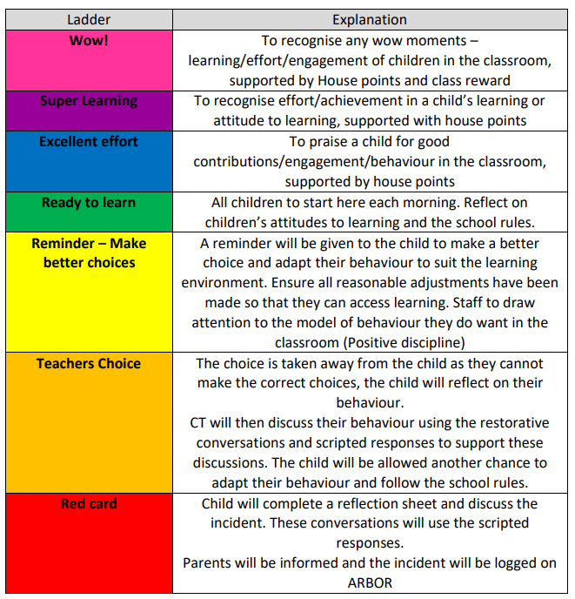
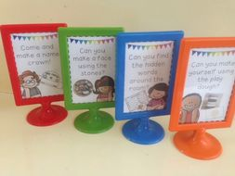




Promoting Behaviours for learning
2. The World We Live In
Child led strategies that promote good habits of behaviours for learning.

Slide 14





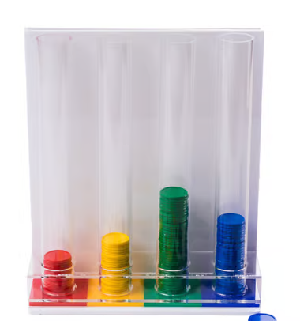

TEAM POINTS Rewards
Outdoor Dinner
Staff Feedback was: “we would like to celebrate children’s individual achievements for house points”….
“We do not feel currently it is fair for all in house points when children try hard with behaviour but their team does not win – it can feel disheartening”
The School Council will now carry out class votes for the award the school will earn over a half term.
Children will be rewarded a house point and be then allowed to vote for the reward they would like.
The votes will be brought together in the final week of a half term and the winning whole school reward will be given to ALL.
We will be launching individual team point awards.
Bronze: 50 points
Silver: 100 points
Gold: 200 points

Slide 15


SWIMMING PROGRESSION
We have brought back swimming certificates that will be awarded when your child is able to confidently complete all skills in the orange boxes. They will be then working towards the blue skills in lessons.
All certificates formats will be found in the 2026-2027 home link books.
You said you would like more information around swimming levels and what your child is able to do and is working towards. We have worked off this feedback and would like to share the outcomes.

Slide 16
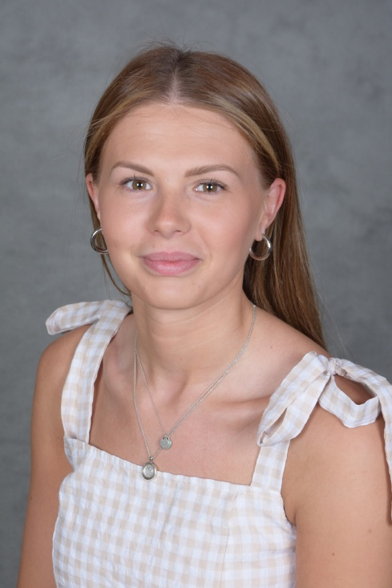
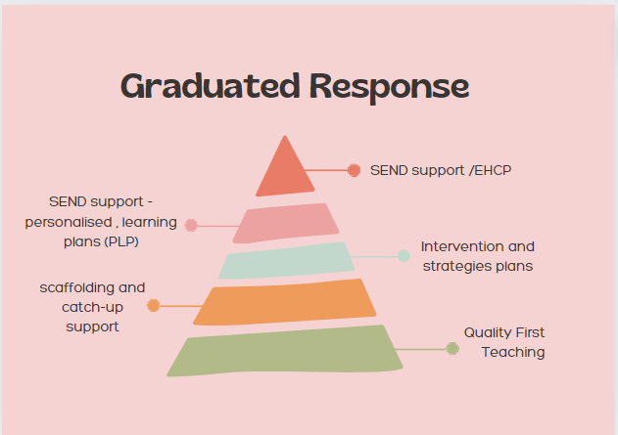




SEND support AT Knypersley First School
SENDco – Miss Massey (Busy Bees Class Teacher)
Our weekly SENDco drop-in session is a Wednesday after school. To book an appointment with us please message via Arbor or phone the office to aid appointment times and schedule.
My role at Knypersley First School is to ensure that every child feels included, championed and most importantly - happy. I ensure the best quality support through personalised provision and intervention as well as the organisation of specific support through outside agencies.
https://www.knypersley.staffs.sch.uk/special-educational-needs-and-disabilities/

Slide 17
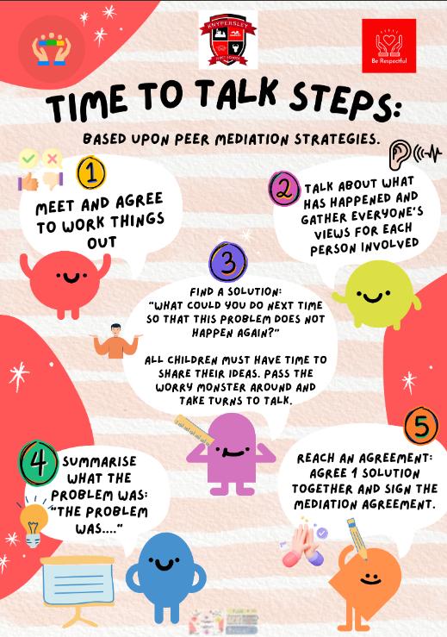
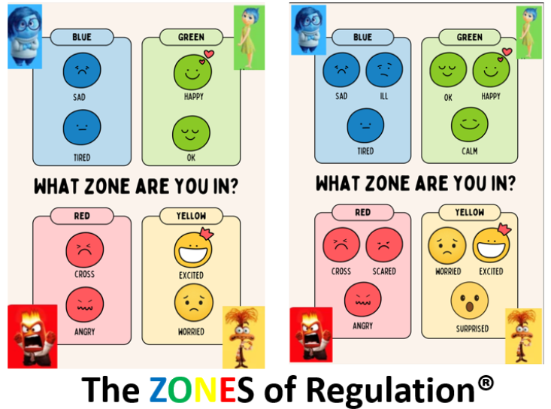
Social, Emotional and Mental Health

Slide 18

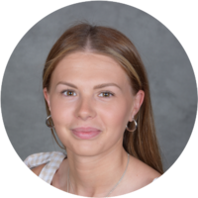
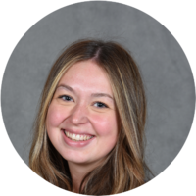
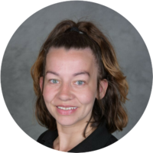
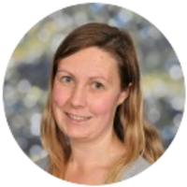
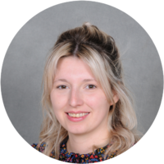


Introduction to The reception team

Slide 19
Class Webpages/ Curriculum overviews
Our year group page hosts a wealth of information that staff refer to throughout the year such as:
  Curriculum Overviews - Overview of learning over the year. This is a great way to pre-teach or to engage with learning theme's as your child is immersed within them in school.
  Class Webpages
  Curriculum drivers – Learning for Life overviews.
  https://www.knypersley.staffs.sch.uk/curriculum/
2. The World We Live In

Slide 20

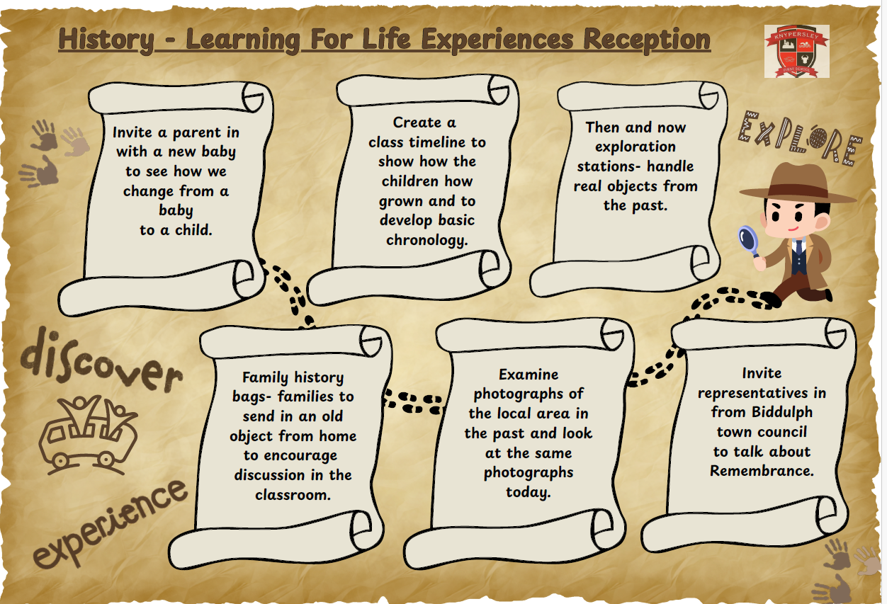


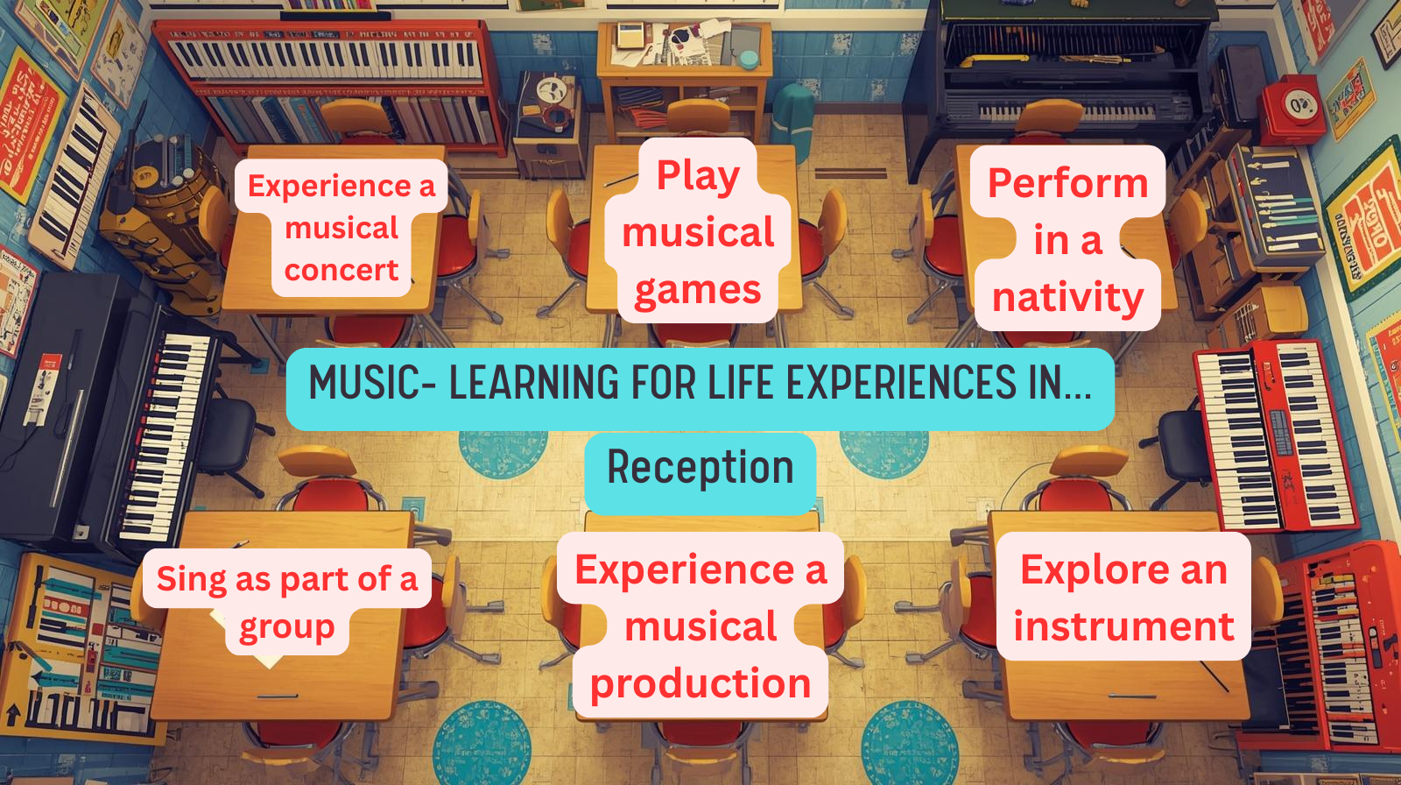




Learning for Life Offer reception

Slide 21
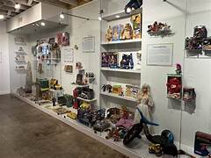

SPREADING THE COST
We will be adding the trips once we have a cost to Parent Pay so that you are able to add payments over the year giving you longer to pay.
TOY MUSEUM TBC
Predicted date: start of the Spring term.
Prices to be confirmed during booking.
You said you would like more awareness as early as possible for trips and events that will require parental funding. We have worked off this feedback and would like to share the outcomes.
PEAK WILDLIFE PARK!
Predicted date: July 2027
Cost based on 2026 trip (subject to change based on up to date costings): £22.30

Slide 22
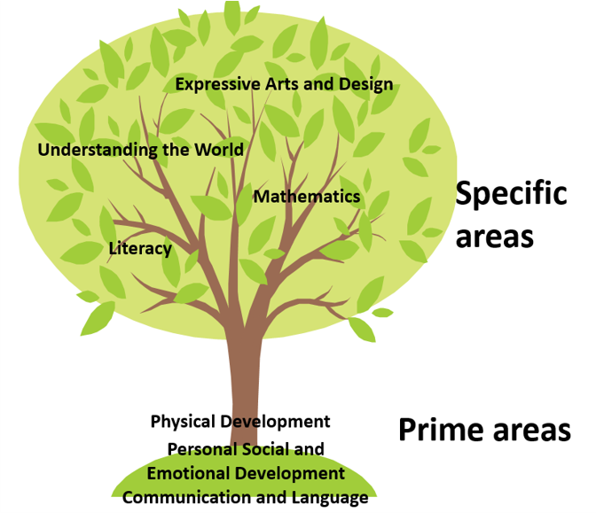
Reception Throughout the Year
https://www.knypersley.staffs.sch.uk/reception/
2. The World We Live In

Slide 23

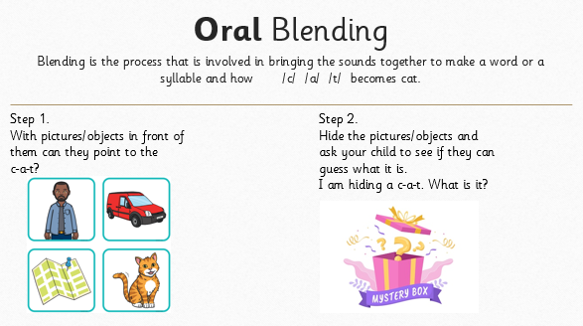
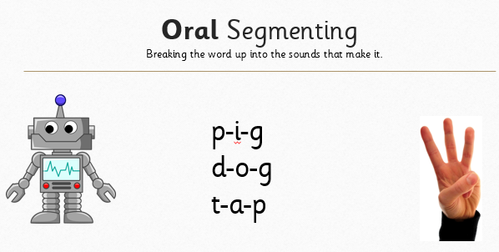
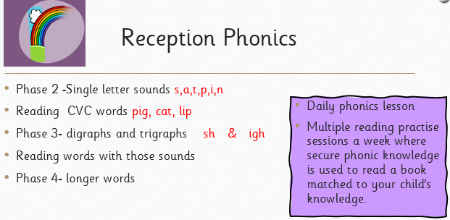
Literacy- Phonics/reading
2. The World We Live In
3x a week reads at home with your child to embed the reading sessions in school. Please record this in your child’s home school links book. Staff will check reading at home and reward children for reading at home.
Your child's home reading book will be swapped on a Friday. Please ensure that your child’s home reading book is returned into school on a Friday.
Please ensure that your child brings in their home school links book each day.

Slide 24


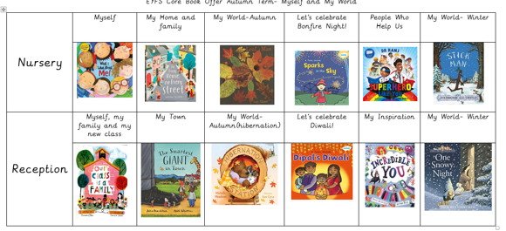



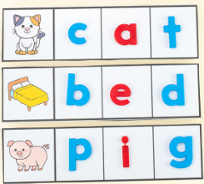
Literacy- writing
2. The World We Live In
Pat a dog

Slide 25



handwriting
1. Children will be taught to form and write letters correctly, fluently and automatically using the Kinetic Letters handwriting programme.
2. This involves 4 main threads
Making the body stronger
Holding the pencil correctly
Learning the letters
Flow and fluency
Joining in later years once previous skills are secured.
3. Explicit handwriting lessons will taught to all children.
Mrs Booth will run a parent workshop in the Autumn term, please come along to find out more!
2. The World We Live In

Slide 26

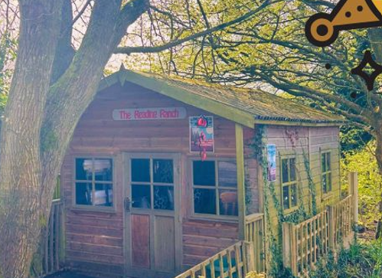


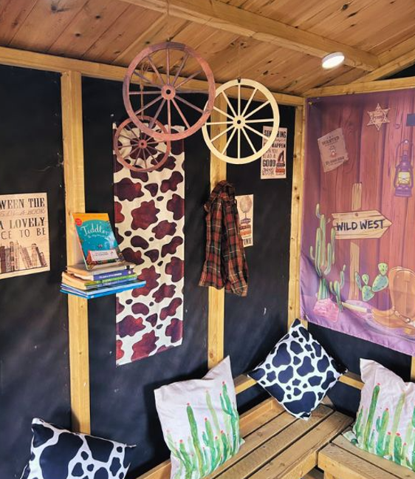

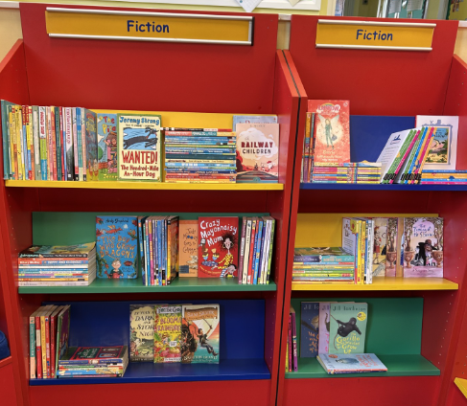
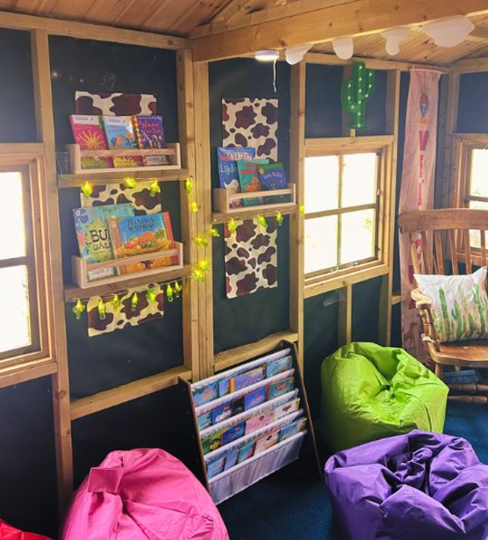
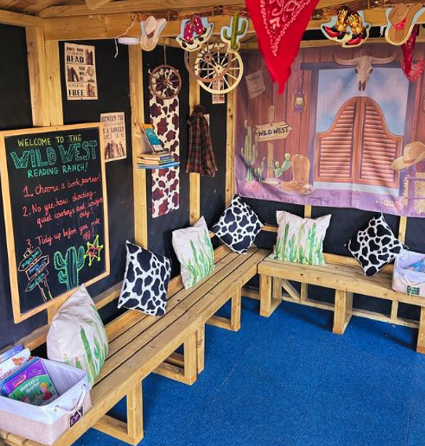




Love of Reading Offer
2. The World We Live In

Slide 27

Library agreement
This year Mrs Booth has fundraised and been given a significant amount of funding to relaunch our school’s love of reading offer.
We have purchased over 200 new books and invested in a new scanning system that our class librarians will lead. Each week during class library sessions the librarian will scan in and out the books and check for damages. Please work with us to protect our enhanced offer by reporting damages and losses ahead of weekly sessions so that we can support replacements.
We hope that this system protects our library offer but also gives our children a sense of responsibility.
Within the Home School Link books Sept 26 we have added a Library Agreement. Please read the agreement and sign so that your child can take part in weekly lending library sessions.
2. The World We Live In

Slide 28

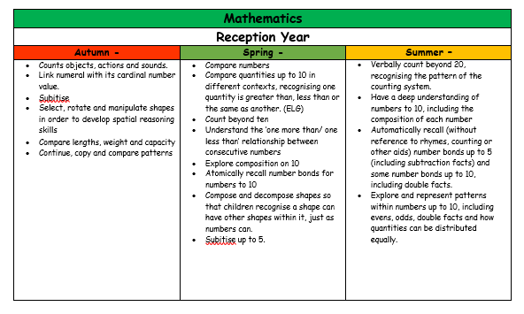

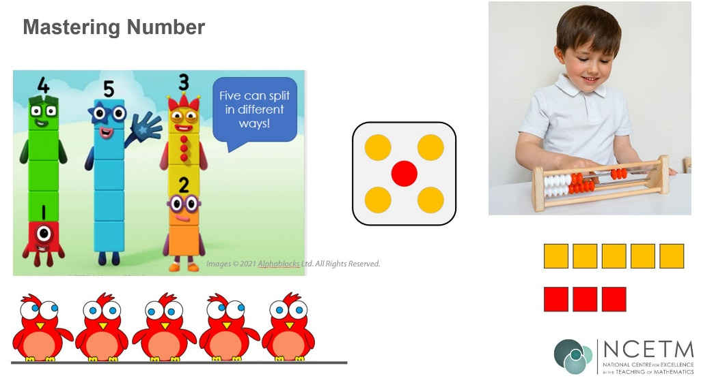
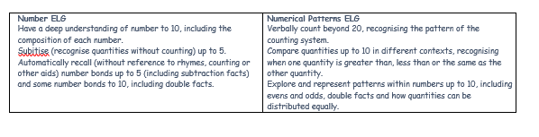
Maths
We follow a scheme called ‘White rose Maths’ and also use ‘Mastery Number’ to aid questioning and deeper level thinking.
The learning environment is set up so that the children can learn through varied fluency.

Slide 29


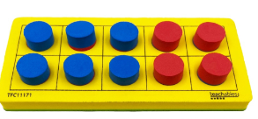

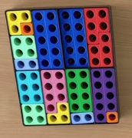

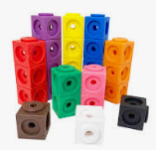

Maths

Slide 30
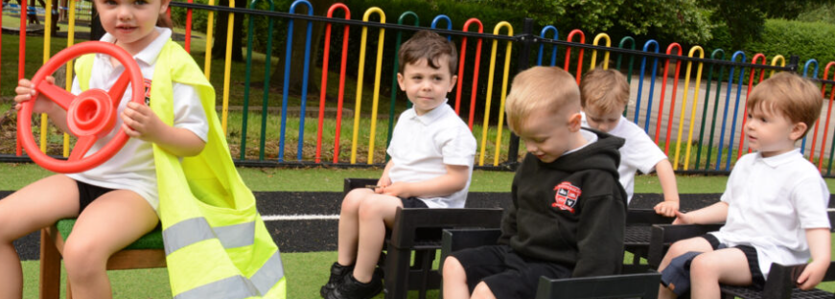
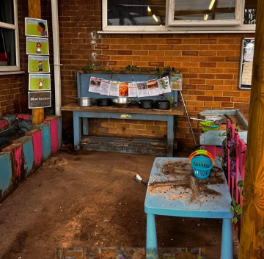
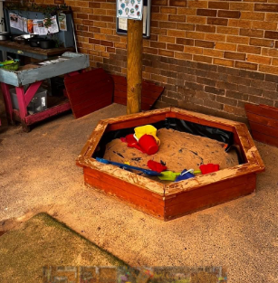
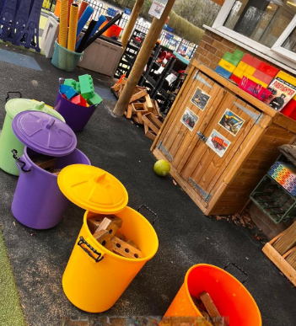
Outside classroom
2. The World We Live In

Slide 31
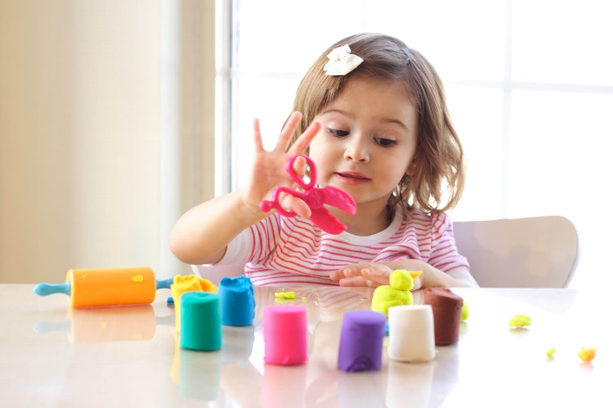
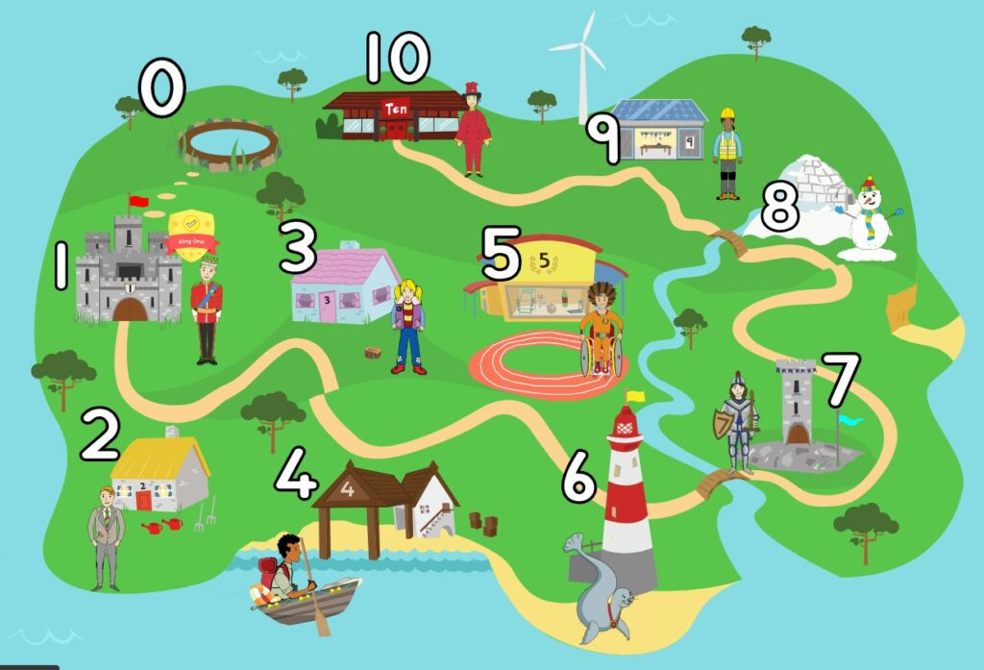
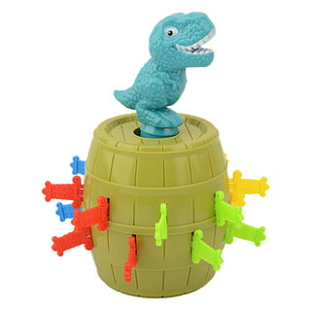

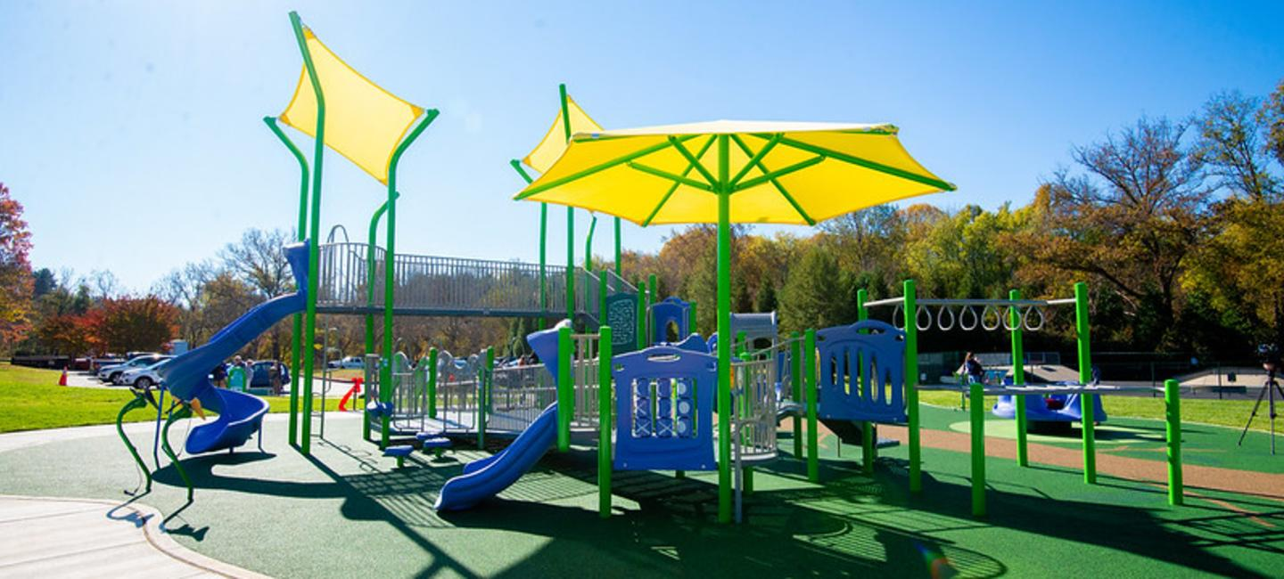
Supporting your child at home
https://www.knypersley.staffs.sch.uk/nursery/
Weekly drop-in sessions
Parent’s evening
Reports
Evidence Me
Learning together sessions
LEARNING FOR LIFE CHALLENGES
Dough Play will support your child’s fine motor development – Youtube ‘Dough Disco’
Ten Town – Introduction to numbers (each child will receive their own log in)
Playing games with your child will support with personal and emotional development.
Visit your local park regularly to support your child’s gross motor development i.e. balance, core strength etc.
Our school follows the Little Wandle phonics and reading scheme.

Slide 32
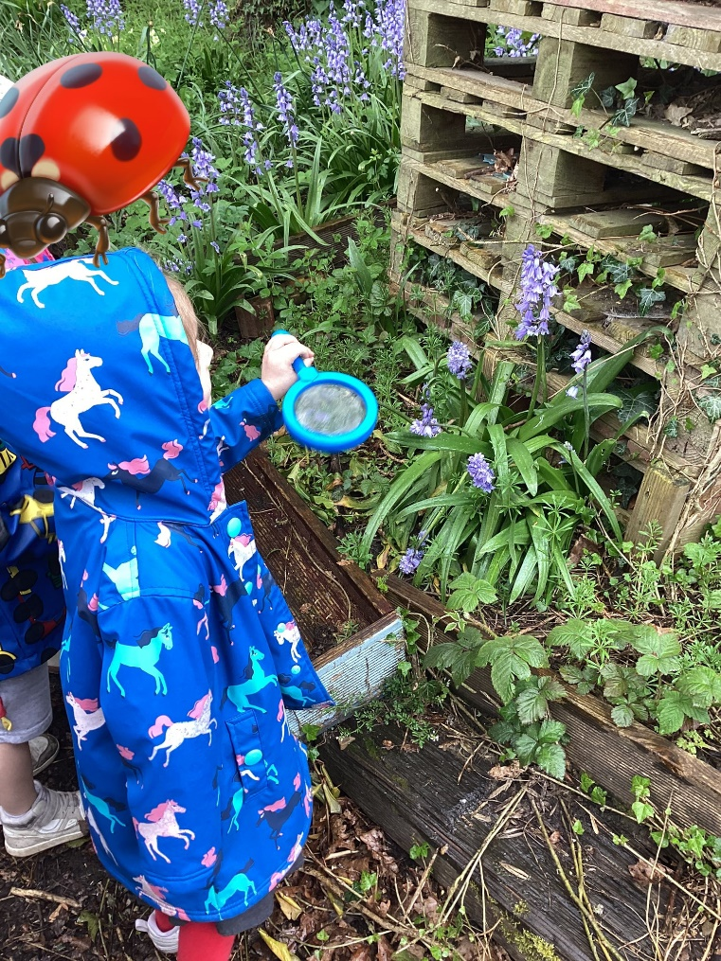
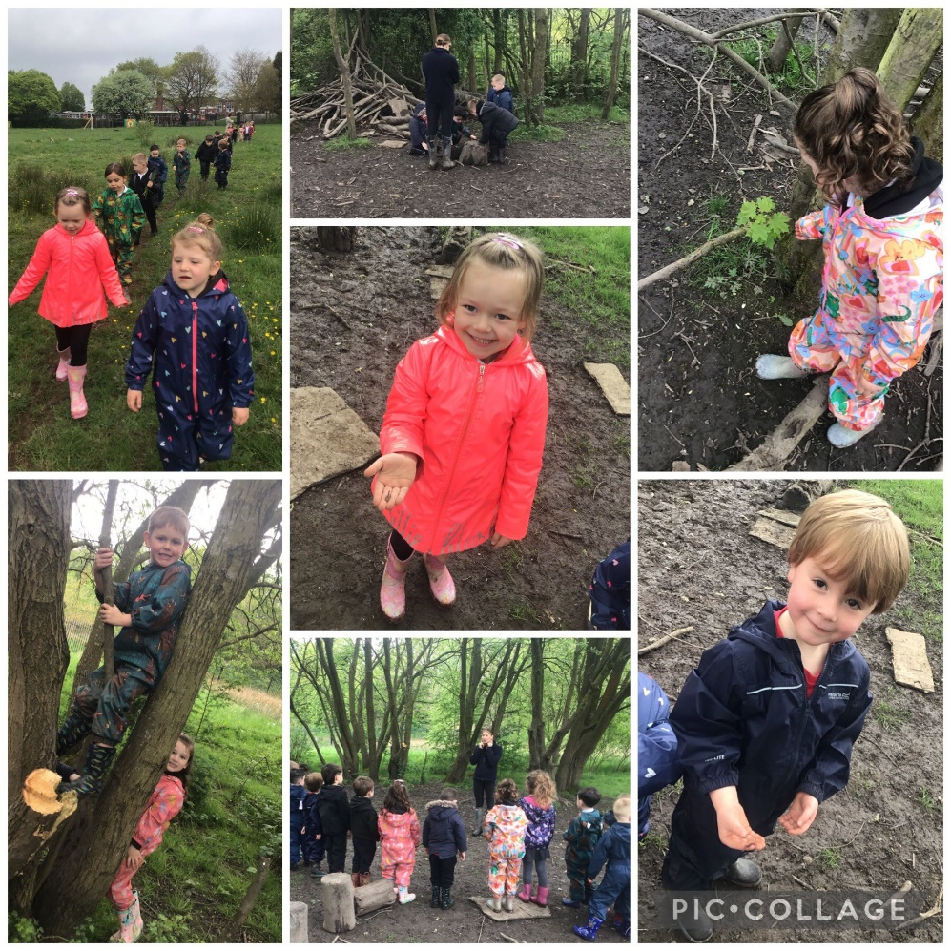





Exciting events
School clubs
Forest School
School disco!
Swimming
Celebration Assembly
School Trips

Slide 33







rECEPTION Essentials
We are a healthy school and only allow water in bottles and healthy lunchboxes. Children can also bring a healthy snack for morning playtime. Please speak to a member of staff if you require support with this.
Please can all medication be signed into school via the main office. No medicine will be accepted on the door.
We are a nut free setting due to allergies identified. Thank you for your support with this.
Children are eligible for Universal Free School meals until KSG 2.
EYFS Uniform:
Black Hoodie
White Polo Top
Black Jogging bottoms/ Leggings
Black shorts or skirt (warmer weather)
Black Velcro Trainers
All uniform is required to be the same therefore items can be easily swapped or misplaced. Please support us by clearly labelling all items including bottles, hats, coats etc.

Slide 34
  And finally …
Receptions PE day is on a Wednesday.
Receptions Swimming day is on a Wednesday. Please wear your EYFS school uniform, bring your swimming kit.
Please remove earrings before school on both PE and swimming days.
2. The World We Live In

Slide 35

  newsletter
All important information / dates will be on the newsletter.
You will be emailed this each Friday.
2. The World We Live In
https://www.knypersley.staffs.sch.uk/newsletters/
Notes:
CL

Slide 36


  Get involved!
We always need help in school. Hearing children read, photocopying, laminating, cutting out, going on visits, in the swimming pool-please speak to a member of staff if you think you would be able to help.
Our wonderful PTFA organise lots of events and raise lots of money for our children-they would welcome new members.
Notes:
CL

Slide 37
Information Packs
Please ensure that before June 18th (Transition Day) you have returned forms within the ‘Welcome To Pack’ that you will be given tonight.
This is to ensure that we have all details to support your child to stay independently for the session.

Slide 38



Thank You!
Miss Massey
Miss Shields
Miss Lunn
Mrs Court
Mrs Barker

