Slide 1

KNYPERSLEY FIRST SCHOOL
Welcome to Reception
2025

Slide 2




What We'll Discuss today
School website
Attendance
Behaviour Policy
Communication
SEND support
Yearly Overviews
How to support at home
Exciting Events
Information Packs

Slide 3





School Website
http://knypersley.staffs.sch.uk/
Policies
Newsletter - Online/ via Arbor (paper copies available via the school office).
E-Safety Guidance
Safeguarding page
PTFA information
School Calendar
Uniform
Lunch menu
Clubs

Slide 4



Communication
We value your communication and feel that it is important that everyone feels heard and valued within our school community.
Below is an outline our the channels of communication within our school:
Arbor
Weekly Drop-in
Arbor is our main platform for direct communication for staff and parents. Arbor messages are check before school and after school by staff between the hours of 8:30-5:30pm. Mrs Taylor in the office checks Arbor frequently throughout the day. Please use Arbor for non-urgent messages, clubs and parent’s evening appointments.
Beyond the formal parents meeting events noted above, our school has always offered a night during every school week where staff are available to answer any questions you may have or to address any concerns which may have arisen. These sessions are between 3.30- 4p.m
Reception drop-in will be on a Thursday
Main Office
Reports/ Parents Evenings.
Please call the school office 01782 973810 to pass on urgent time limted messages for example-informing us that your child is absent, booking your child into Kid Zone (due to an emergency). Please be mindful that this is NOT for non-urgent messages that could be passed on by staff at the door.
Reports are sent three times a year at the end of every term. Parent’s Evenings are then run twice a year at the end of Autumn and Spring half terms in order for staff to inform you of successes and next steps.
Parent’s evenings can be book via Arbor.
Notes:
Newsletter

Slide 5

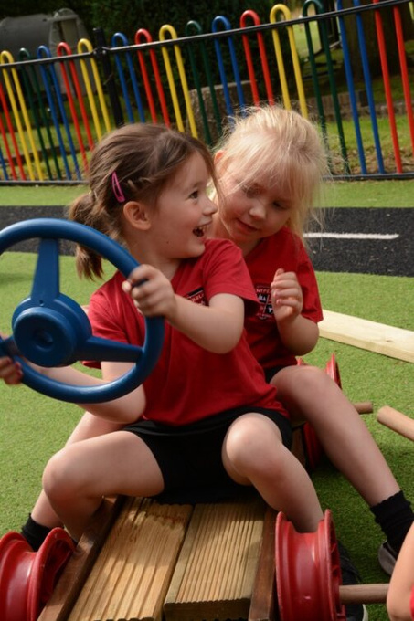


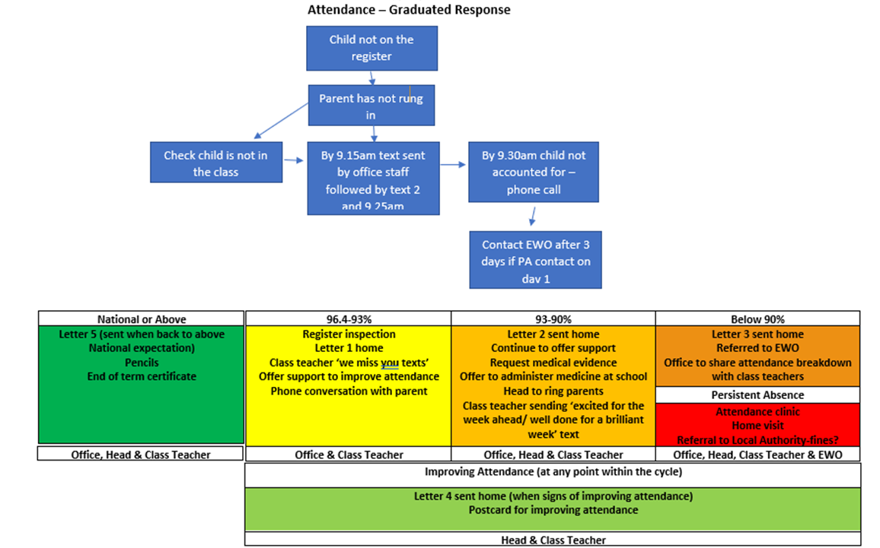



Attendance
Attendance is tracked daily
It is of the up-most importance that you report absences. This is to support our safeguarding procedures
Forming good habits
Supports progress
Increased wellbeing
Supports to build friendships
Holiday request forms can be collected from the school office. We encourage you to avoid taking holidays within school time.

Slide 6
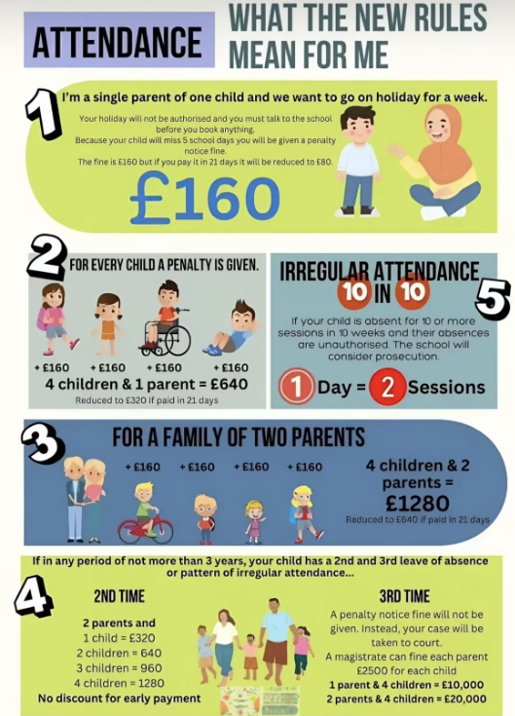

Attendance
Forming good habits
Supports progress
Increased wellbeing
Supports to build friendships
Notes:
CL

Slide 7






Class Webpages/ Curriculum overviews
Our year group page hosts a wealth of information that staff refer to throughout the year such as:
Curriculum Overviews - Overview of learning over the year. This is a great way to pre-teach or to engage with learning theme's as your child is immersed within them in school.
Class Webpages
Curriculum drivers i.e. Careers Week, Faith in Focus Etc.
https://www.knypersley.staffs.sch.uk/curriculum/
2. The World We Live In

Slide 8




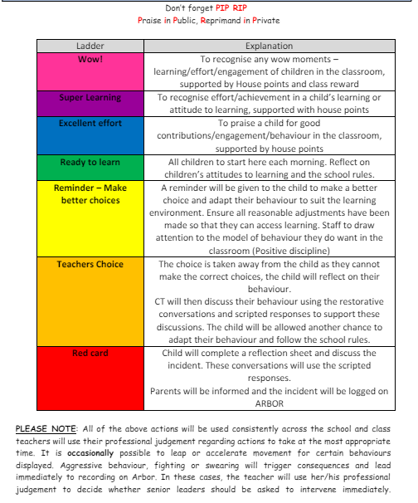

Positive behaviour management
https://www.knypersley.staffs.sch.uk/wp-content/uploads/2023/08/Knypersley-Positive-Behaviour-Policy-23-24-5.pdf
Our 3B rules are consistent from nursery to Year 4 which supports children in understanding expectations for behaviour.
Each class starts the year by writing their own class 3B expectations which develop over the years as they do themselves.
Our Positive Behaviour Policy is based upon restorative conversations and practice. Ensuring all children use mistakes as a chance to learn and better themselves.
Parents are notified if their child reaches a ‘red card’. This will mean that your child has needed multiple reminders and have not been able to follow the 3Bs over a period of time.
If your child reaches ‘WOW’ this is down to them following the 3B expectations consistently enough to reach a reward. Moving to WOW is not done due to a one off event or learning achievement.
Notes:
Celebration Assembly – Certificates
3bs
Star of the week
Star reader

Slide 9

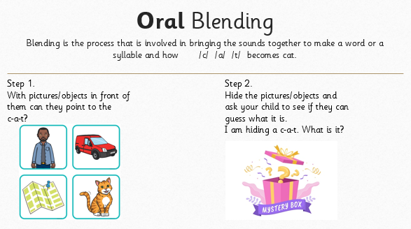
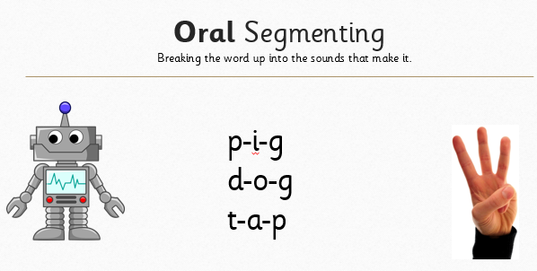
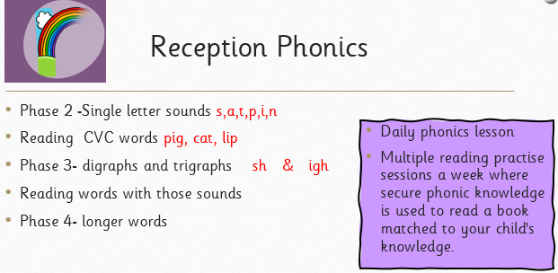
Literacy- Phonics/reading
2. The World We Live In
3x a week reads at home with your child to embed the reading sessions in school. Please record this in your child’s home school links book. Staff will check reading at home and reward children for reading at home.
Your child's home reading book will be swapped on a Friday. Please ensure that your child’s home reading book is returned into school on a Friday.
Please ensure that your child brings in their home school links book each day.

Slide 10



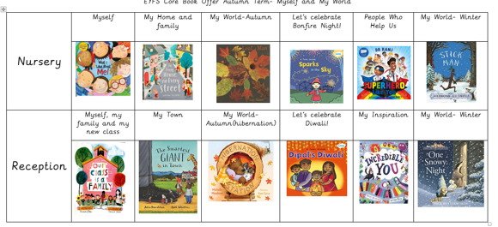



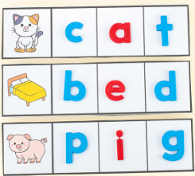
Literacy- writing
2. The World We Live In
Pat a dog

Slide 11

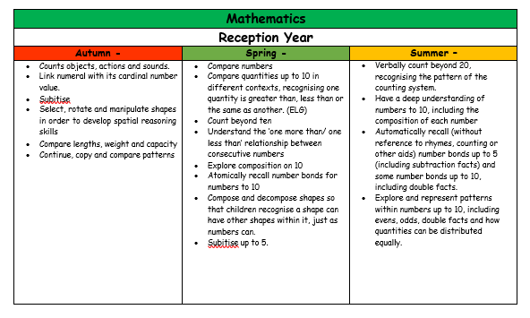

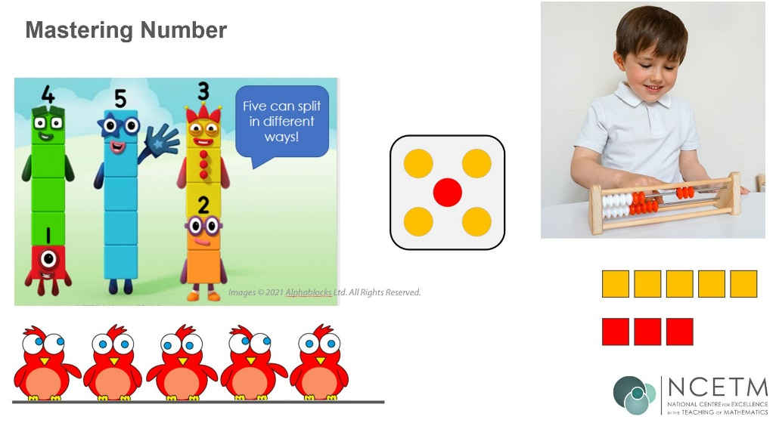
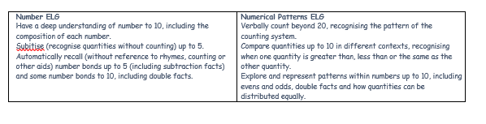
Maths
We follow a scheme called ‘White rose Maths’ and also use ‘Mastery Number’ to aid questioning and deeper level thinking.
5x weekly sessions of maths.
The learning environment is set up so that the children can learn through varied fluency.

Slide 12


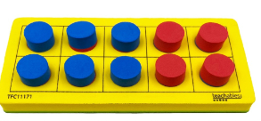
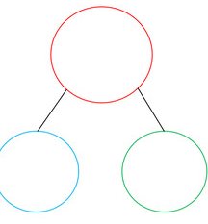
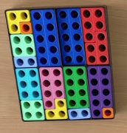

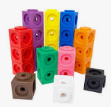

Maths

Slide 13
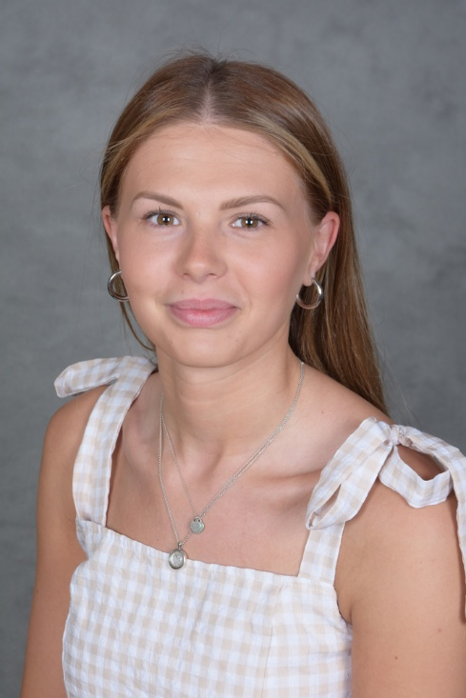
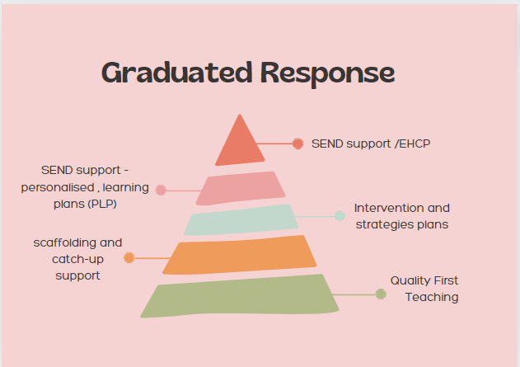

SEND support AT Knypersley First School
SENDco – Miss Massey (Busy Bees classteacher)
)
Our weekly SENDco drop-in session is a Wednesday. To book an appointment with us please message via Arbor to aid appointment times and schedule.
https://www.knypersley.staffs.sch.uk/special-educational-needs-and-disabilities/

Slide 14
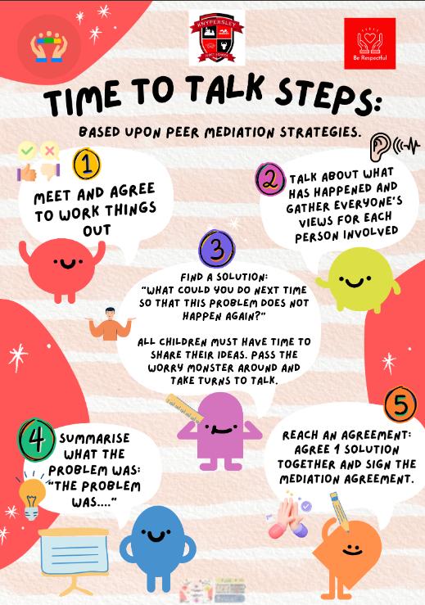
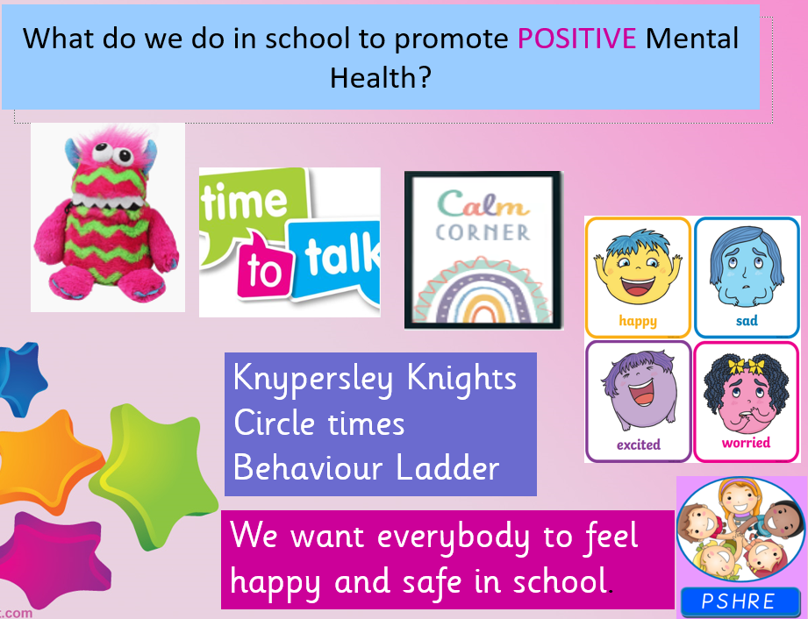
Social, Emotional and Mental Health
Forming good habits
Supports progress
Increased wellbeing
Supports to build friendships

Slide 15
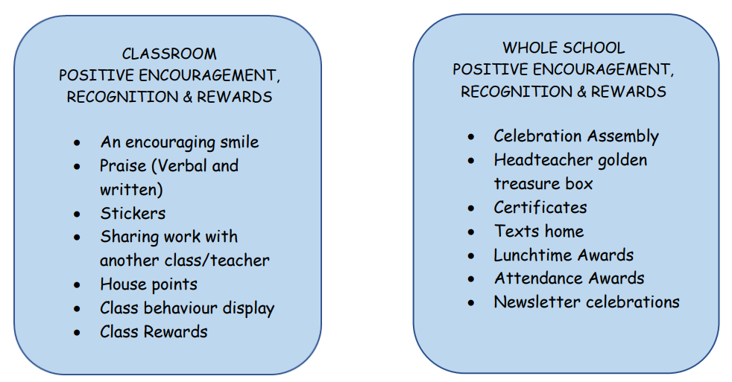
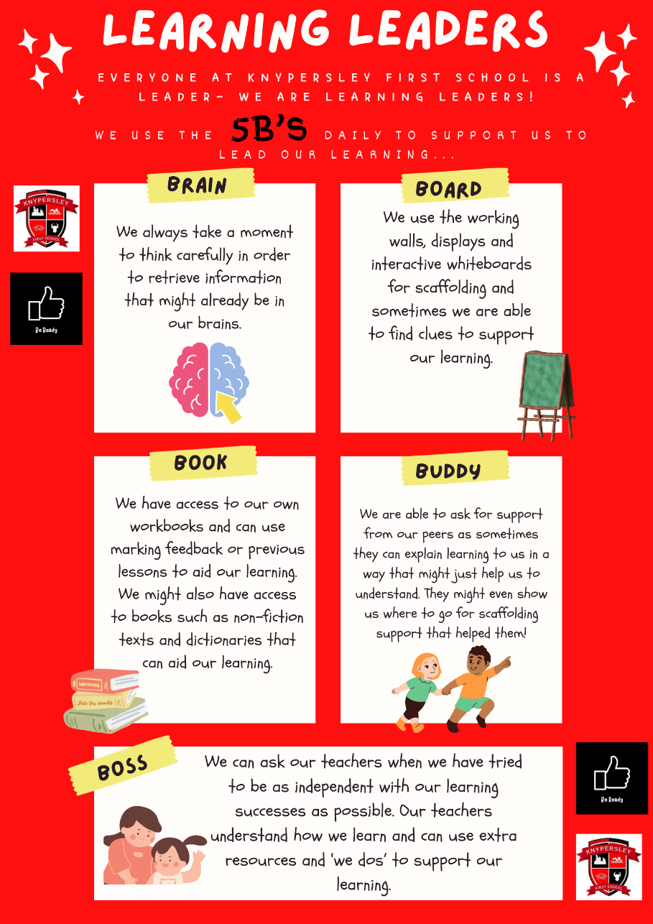
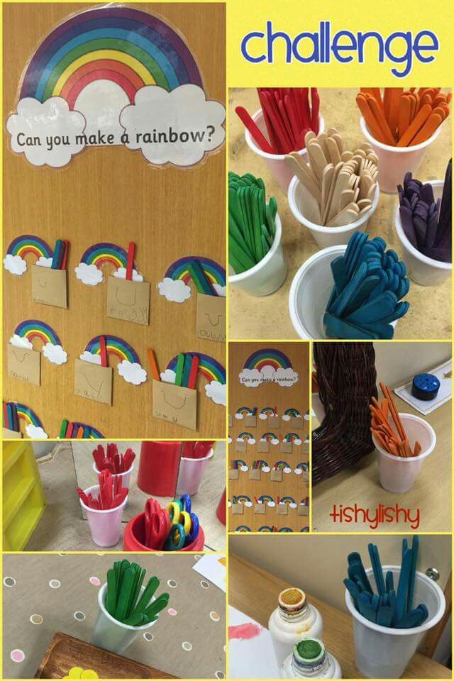
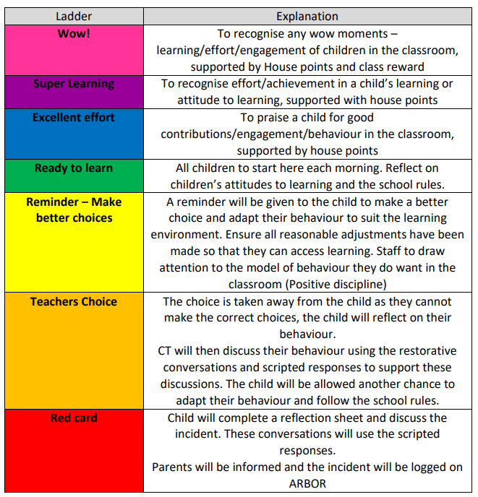
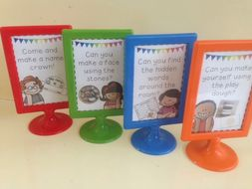



Promoting Behaviours for learning
2. The World We Live In
Child led strategies that promote good habits of behaviours for learning.

Slide 16
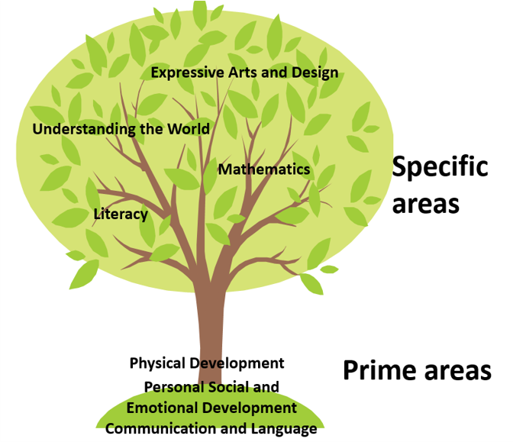
Reception Throughout the Year
https://www.knypersley.staffs.sch.uk/reception/
2. The World We Live In

Slide 17
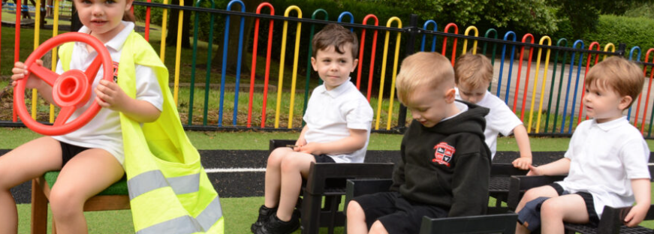
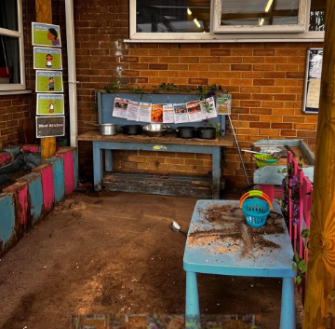
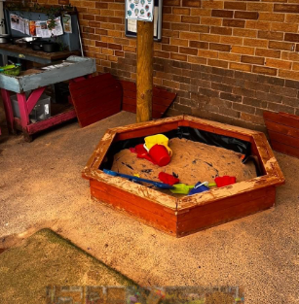
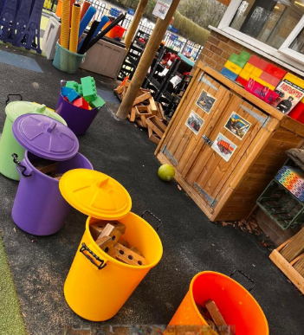
Outside classroom
2. The World We Live In

Slide 18
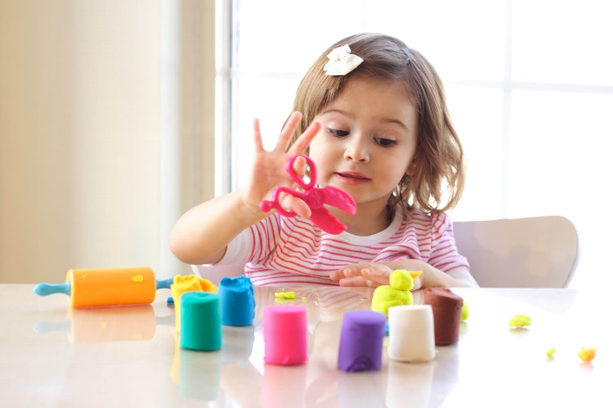
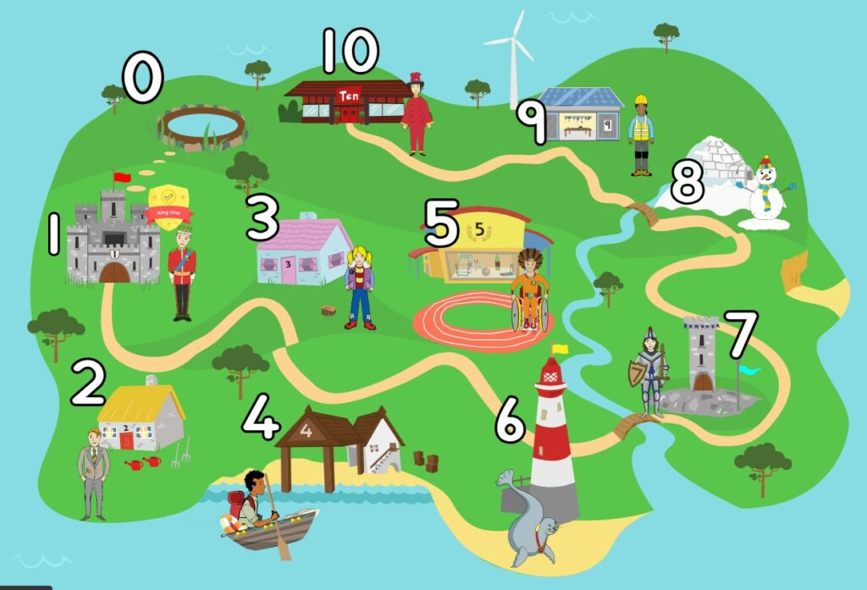
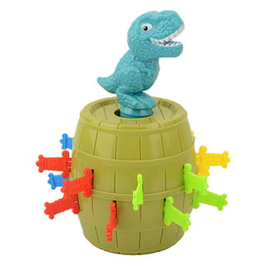

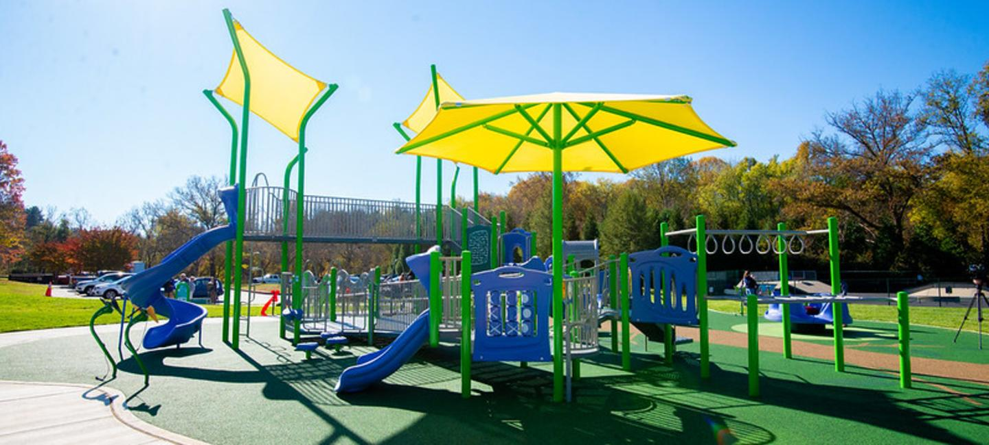
Supporting your child at home
https://www.knypersley.staffs.sch.uk/nursery/
Weekly drop-in sessions
Parent’s evening
Reports
Evidence Me
Learning together sessions
Dough Play will support your child’s fine motor development – Youtube ‘Dough Disco’
Ten Town – Introduction to numbers (each child will receive their own log in)
Playing games with your child will support with personal and emotional development.
Visit your local park regularly to support your child’s gross motor development i.e. balance, core strength etc.
Our school follows the Little Wandle phonics and reading scheme.

Slide 19
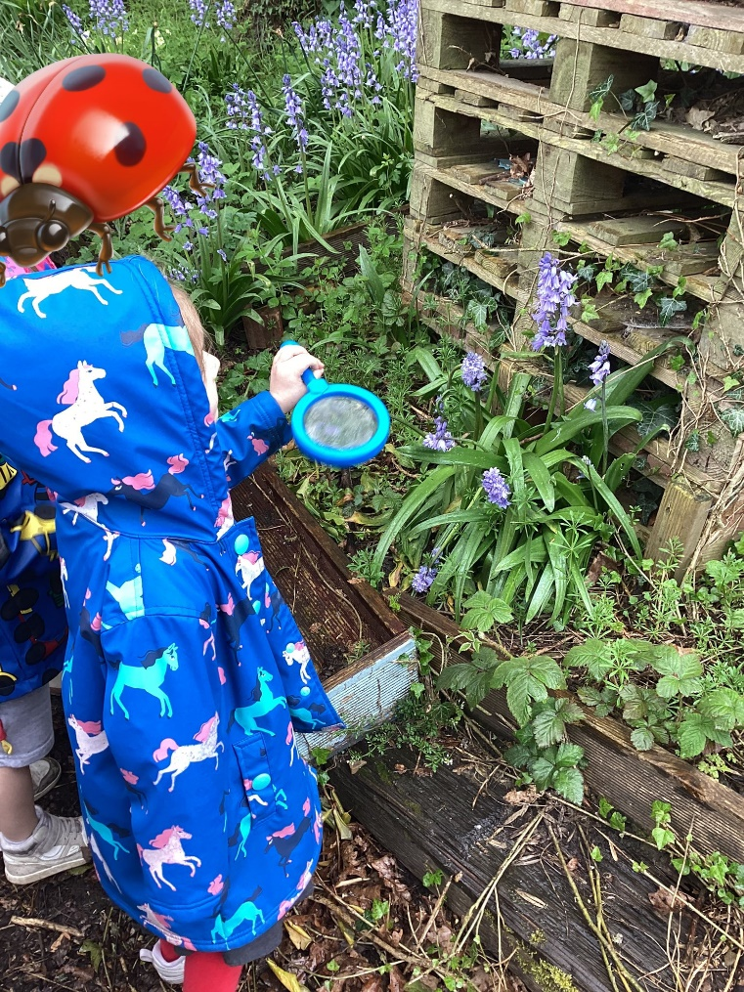
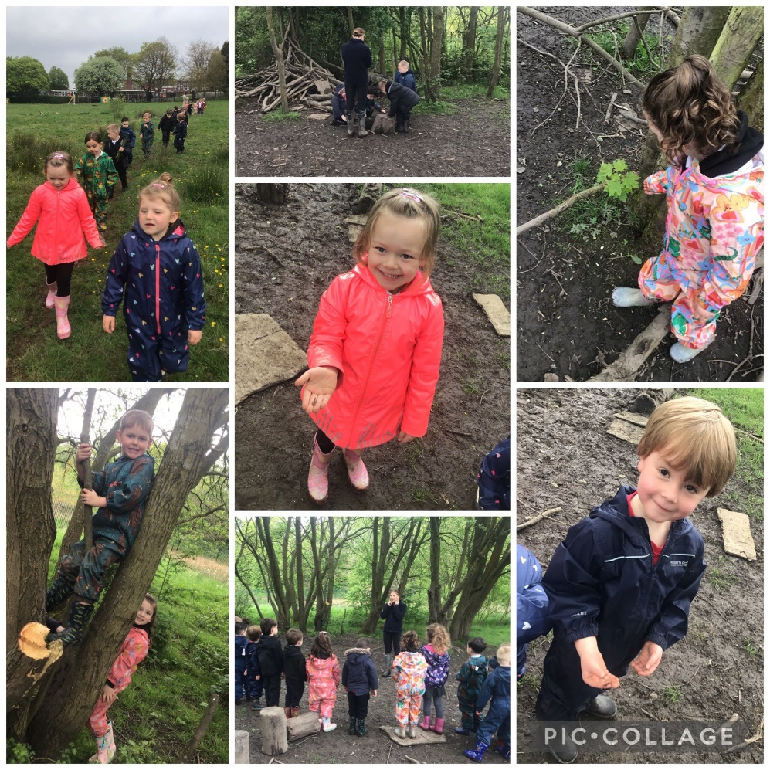
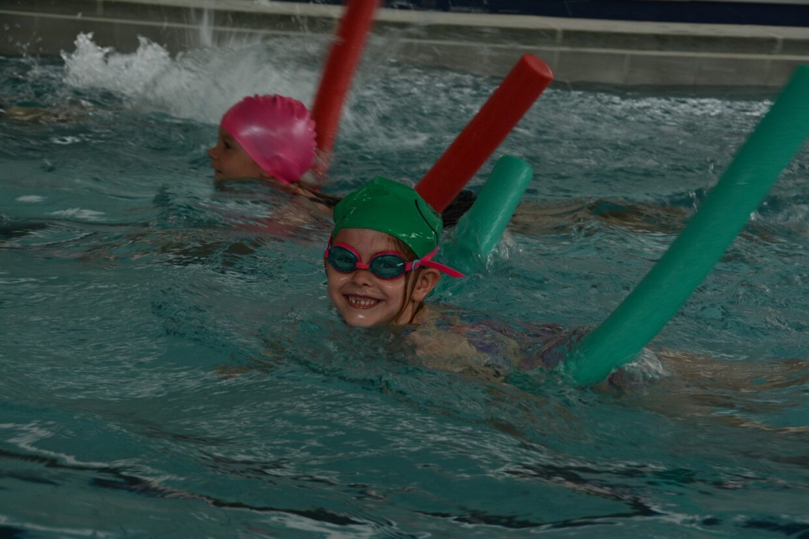
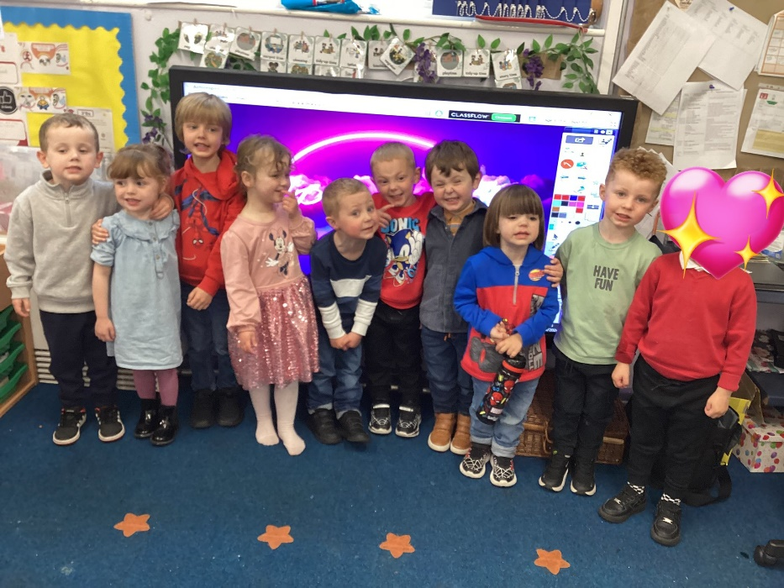
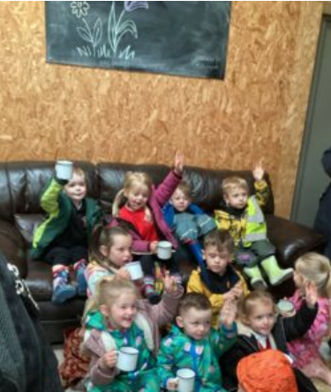
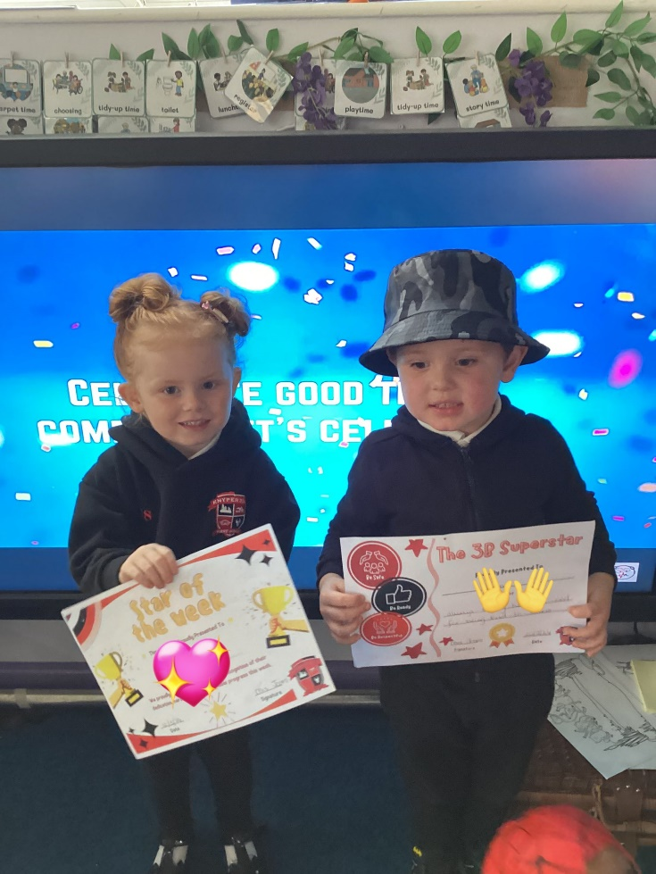
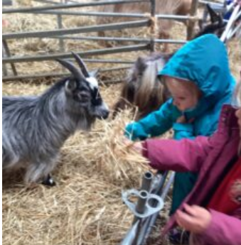
Exciting events
School clubs
Forest School
School disco!
Swimming
Celebration Assembly
School Trips

Slide 20

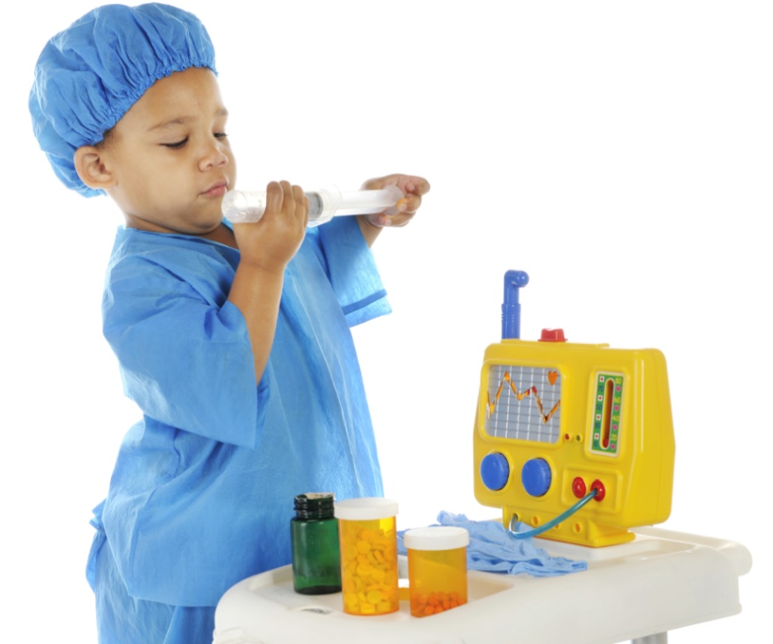

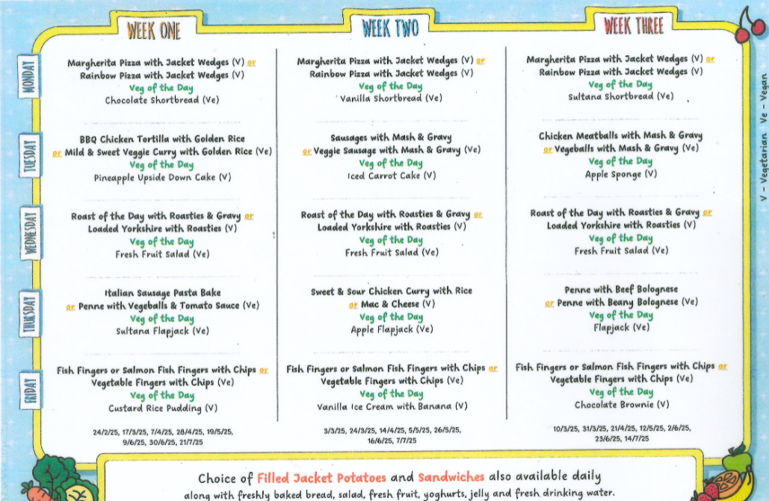
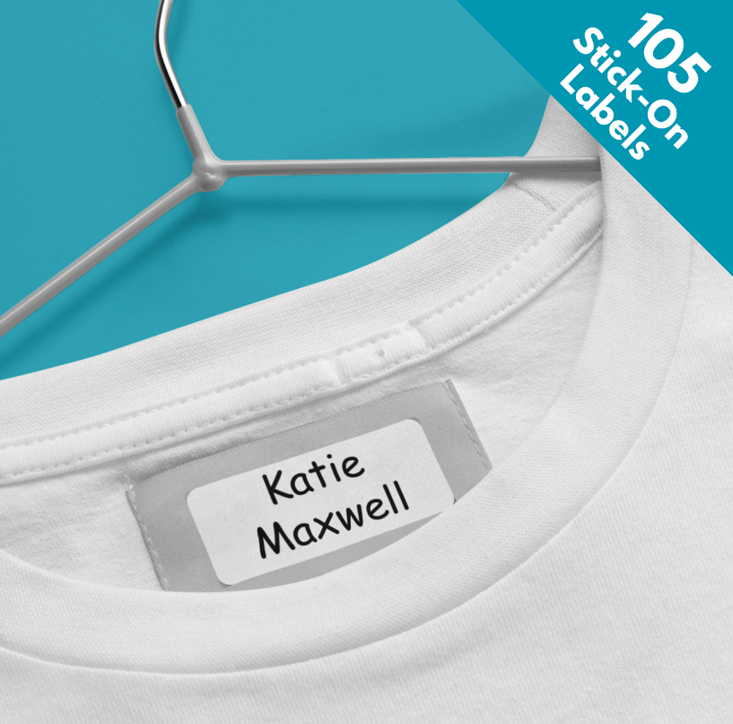
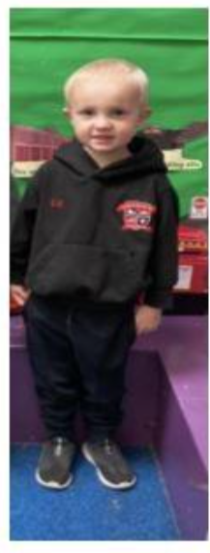

rECEPTION Essentials
We are a healthy school and only allow water in bottles and healthy lunchboxes. Children can also bring a healthy snack for morning playtime. Please speak to a member of staff if you require support with this.
Please can all medication be signed into school via the main office. No medicine will be accepted on the door.
We are a nut free setting due to allergies identified. Thank you for your support with this.
Children are eligible for Universal Free School meals until KSG 2.
EYFS Uniform:
Black Hoodie
White Polo Top
Black Jogging bottoms/ Leggings
Black shorts or skirt (warmer weather)
Black Velcro Trainers
All uniform is required to be the same therefore items can be easily swapped or misplaced. Please support us by clearly labelling all items including bottles, hats, coats etc.

Slide 21

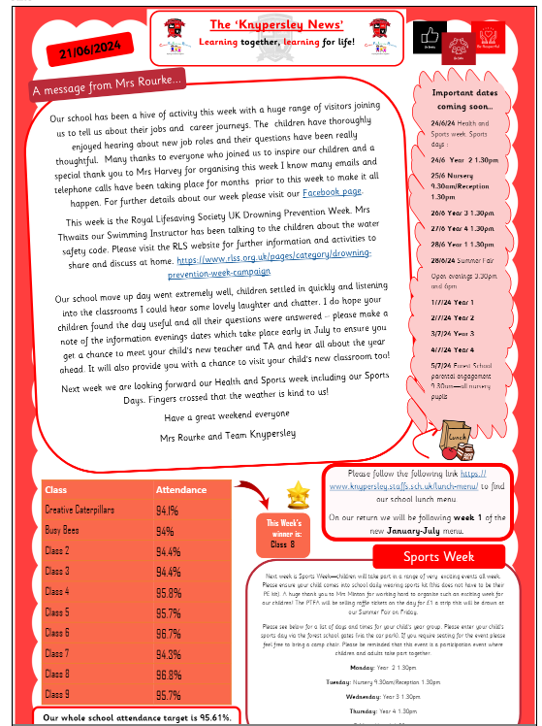
newsletter
All important information / dates will be on the newsletter.
You will be emailed this each Friday.
2. The World We Live In
https://www.knypersley.staffs.sch.uk/newsletters/
Notes:
CL

Slide 22


Get involved!
We always need help in school. Hearing children read, photocopying, laminating, cutting out, going on visits, in the swimming pool-please speak to a member of staff if you think you would be able to help.
Our wonderful PTFA organise lots of events and raise lots of money for our children-they would welcome new members.
2. The World We Live In
Notes:
CL

Slide 23
Information Packs
Please ensure that before June 19th (Transition Day) you have returned forms within the ‘Welcome To Pack’ that you will be given tonight.
This is to ensure that we have all details to support your child to stay independently for the session.

Slide 24



Thank You!
Miss Massey
Miss Shields
Miss Lunn
Mrs Court
Mrs Barker

