Slide 1
Y4 Standon Bowers Residential 2025
Wednesday 26th February – friday 28th february

Slide 2
AGENDA OF THE PRESENTATION
Introduction/Purposes of the trip
What to expect (activities, accommodation, adults, meals)
What to bring (kit list, money, medication)
Communication (Facebook, mobile phones)
Logistics (travel, accommodation, forms)
Final Words/Any Questions?

Slide 3
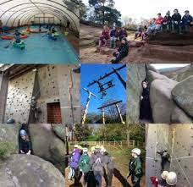
Introduction
Welcome
Wednesday 26th February– Friday 28th February
First time away from home
Notes:
Exciting time
Could organise some sleep overs before to help with being away from home.

Slide 4
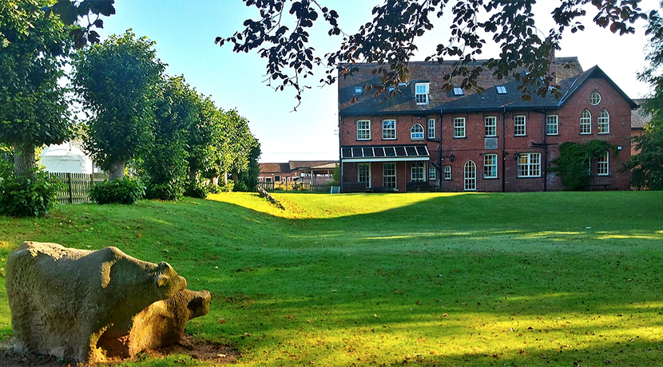
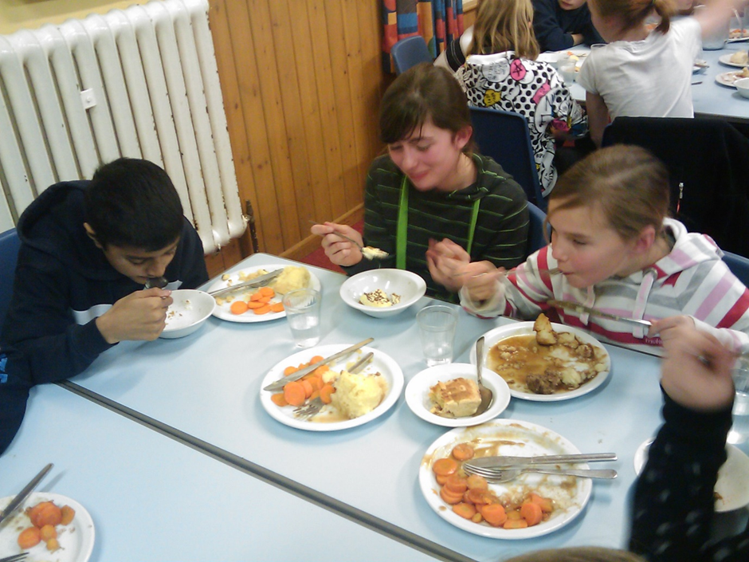
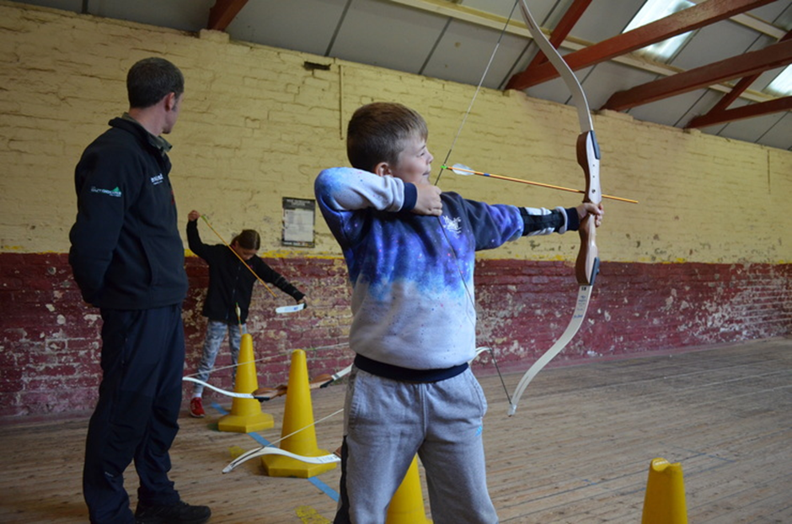
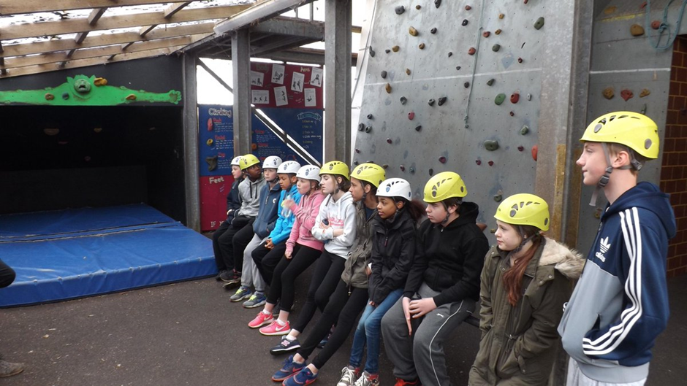
What to expect
Adults
Accommodation
Activities
Meals
Chores
Notes:
Adults- taking our adults- list adults. We will be there for the whole trip, we sleep over with them. We sit outside the dorms until everyone settles. Our rooms are accessible to the children. We will be available day and night
We take part in all activities with the children and each group has an instructor. There is always an onsite member of Standon Bowers staff.
The boys are in one dorm, girls are in the other dorm- please practise making a bed, single duvet and base sheet.
Lots of exciting activities which we will show you further in the presentation. On the website it shows BMX and water sports but we don’t do those due to age restrictions.
All meals are provided, hearty portions, a menu will be provided closer to. We can advise Standon Bowers on any dietary requirements.
Any fussy eaters please let us know.
All groups get chores to get earn points for their team. Chores don’t take too long they have time to explore and free time.

Slide 5
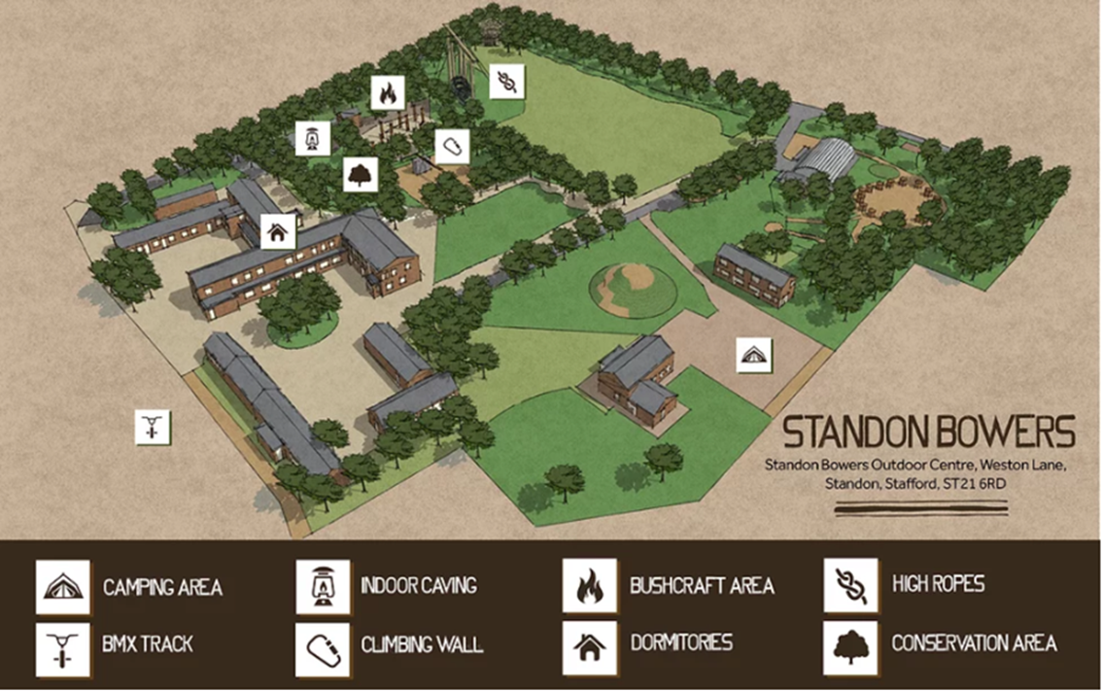

Slide 6
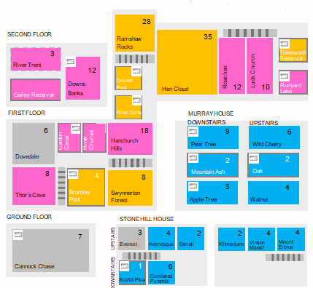

Slide 7
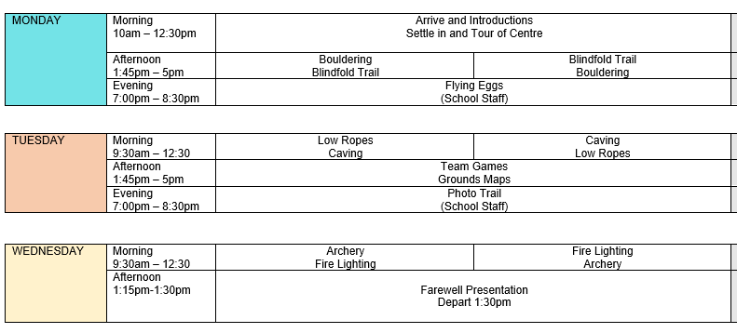
Group A

Slide 8
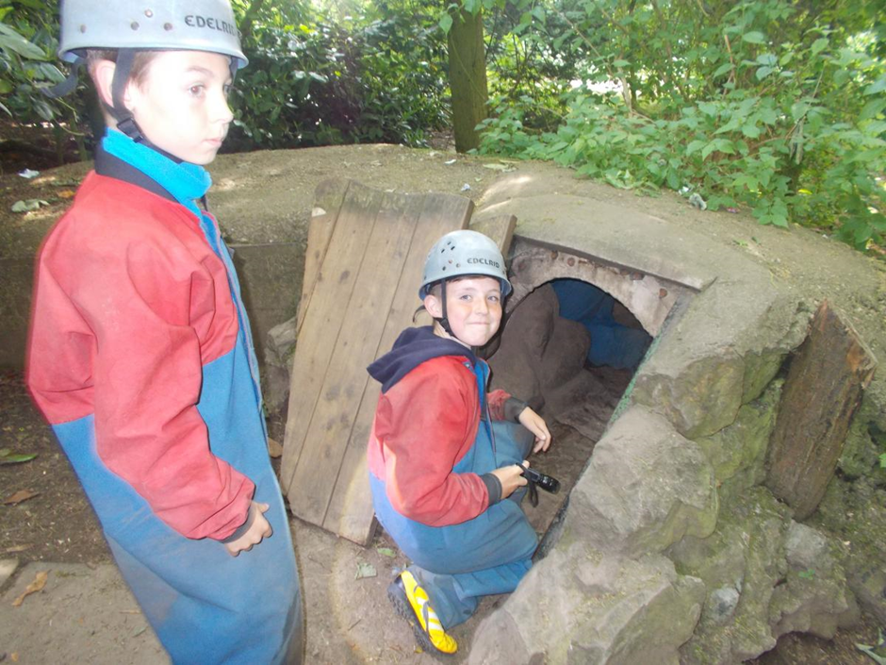
What to bring
Kit list
Money
Medication
What will be provided?
Notes:
You will be given a kit list- most important- waterproof coat, wellies or boots, indoor and outdoor trainers specifically labelled so children know which is which.
Name every item- socks, underwear, towels everything!
Pack case with your child so they know what is in it. Don’t take hairspray or spray deodorant. The smoke alarms will go off and we will end up outside in the night. If they need deodorant they will need to bring roll on.
Money- No more that £5 for the gift shop
Medication- all medication must be handed to member of staff, inhaler, multi vitamins. Can’t take risk of children giving meds to others.
There will be a medication form.
Provided- pillow, mattress, duvet. They need duvet and pillow cover.
They are allowed to take a small snack- small packet of haribo, or small bag of crisps not share bags.

Slide 9
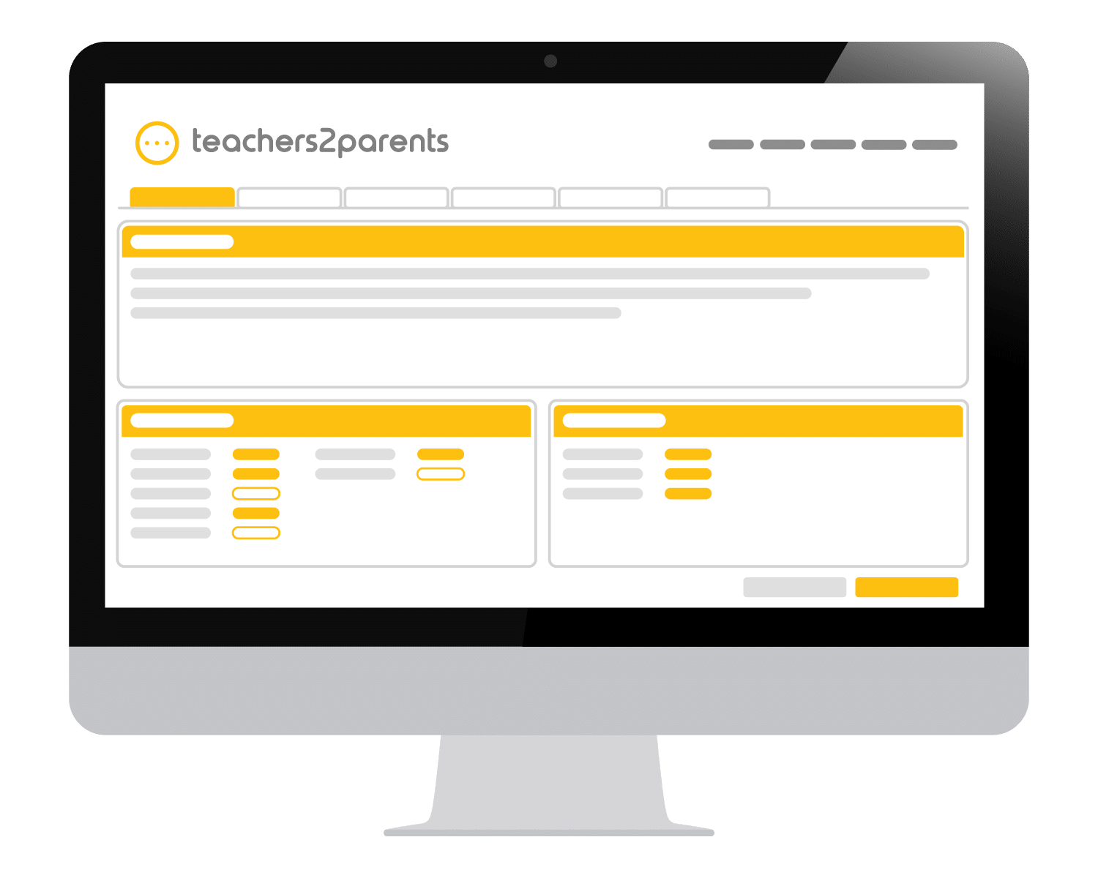
Communication
Facebook
Mobile Phones
In the event of injury…
Office updates
Notes:
We will tweet when we can and what we can however we cannot keep a track of exactly who we have tweeted. Limited internet access. Our role to be with your children not just to follow them and take pictures.
No technology for any child- no tablets, watches, phone, game consoles.
Staff have mobile phones for emergency use only and to keep school updated.
In the event of the injury you will be contacted by the school office. If you receive a call from an unknown or blocked number it could be us if we need to administer calpol.
Office updates will update your periodically to let you know when we arrive and when we are due back to school.
Please do not contact the office staff.

Slide 10
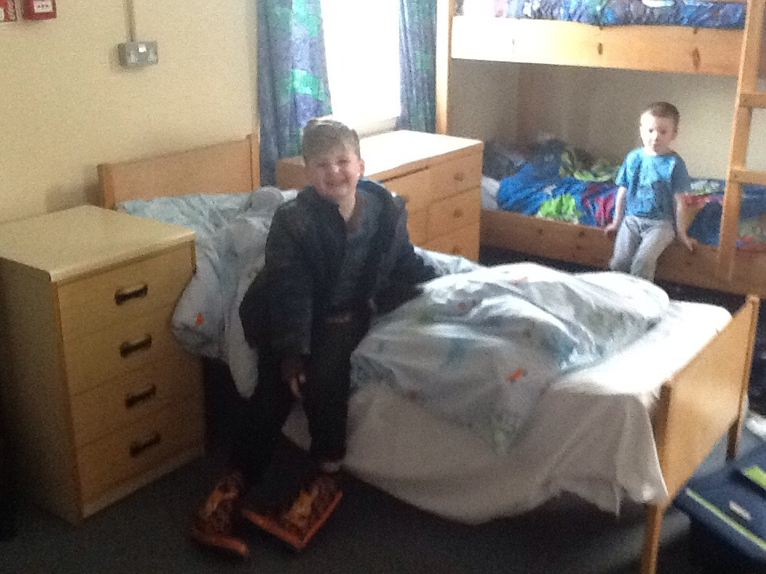
Logistics
Travel
Forms to fill in
Notes:
Travel by coach, if they get travel sick put it on the form and give the medication to a member of staff.
Forms to fill in will be given closer to the date. Please fill in promptly and give back to the staff.

Slide 11
Final Words
Character building
Fantastic for transition
Building friendships
Confidence, Independence and Resilience
Notes:
Fantastic experience for independence, We see a real difference in them when we return.
Great chance to meet new friends as we are going with Kingsfield- for transition.

