Slide 1
Knypersley First School

Slide 2
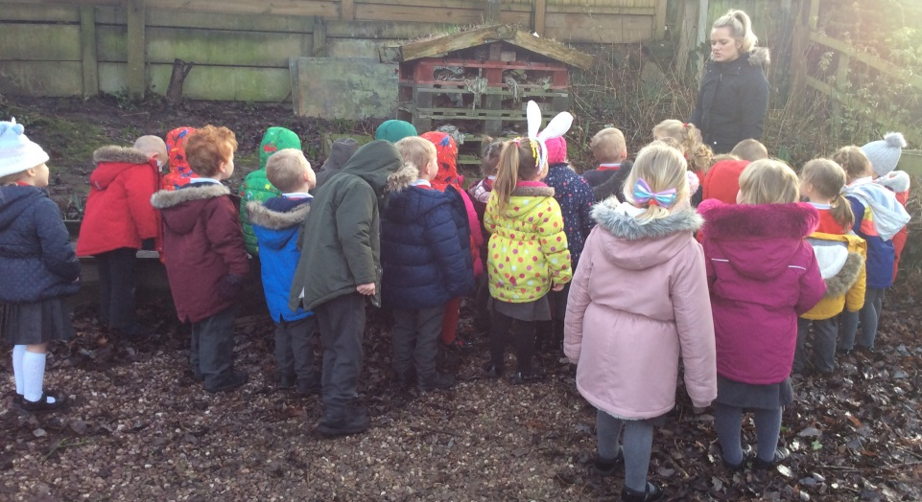
EYFS at Knypersley First School
The aim of this Welcome to Meeting is to provide you with an overview of the EYFS
Home – School Links
How to help your child to succeed at school
Reception and Nursery Check lists

Slide 3
Our Family is Bigger Than You Might Think!

Slide 4
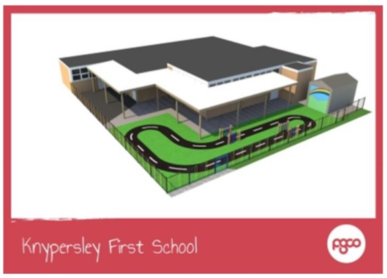
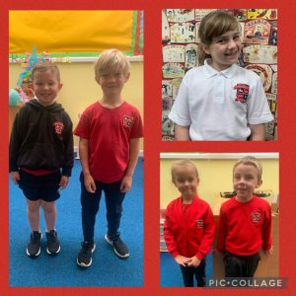
Knypersley News 2021

Slide 5
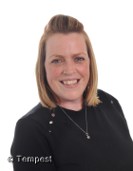
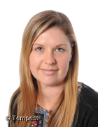
The Who’s Who of Nursery!
Nursery:
Mrs Jervis– Nursery Lead
Nursery Learning Support
Mrs Ford

Slide 6
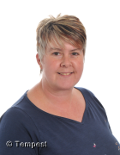
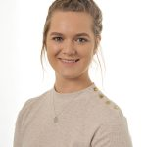
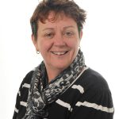
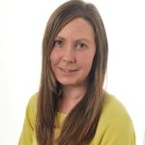
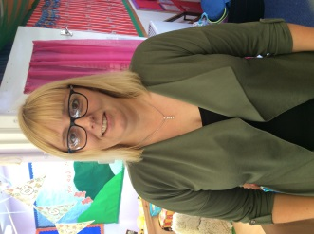
The Who’s Who of the EYFS..
Creative Caterpillars:
Mrs Beckett –Class teacher/ SENCO
Busy Bees:
Miss Leese–Class teacher/ EYFS Lead
Reception Learning Support Team
Mrs Hutchinson, Mrs Swift and Mrs Court

Slide 7
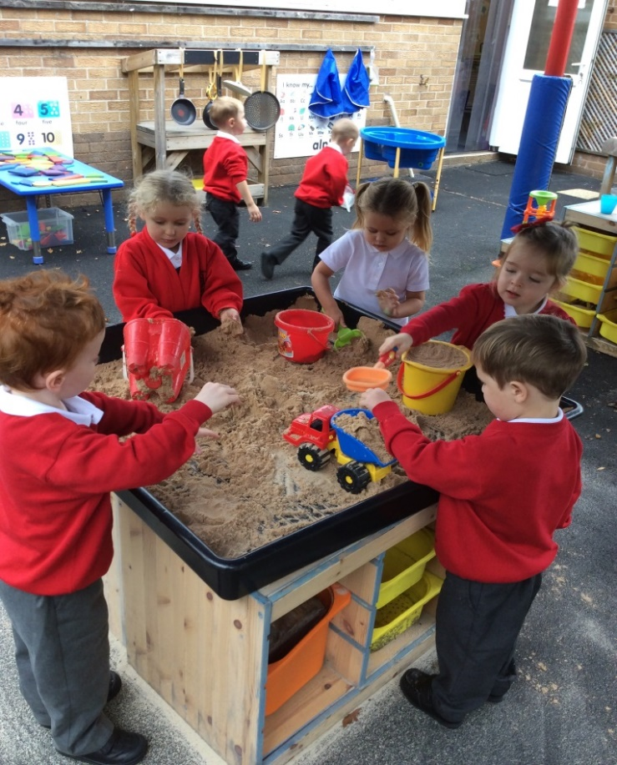
Reception and Nursery are part of
the EYFS
What does EYFS mean?
Early Years Foundation Stage
We learn through our play
We explore the world around us through real life experiences
Key life skills are developed i.e. CAL, PD, PSED

Slide 8
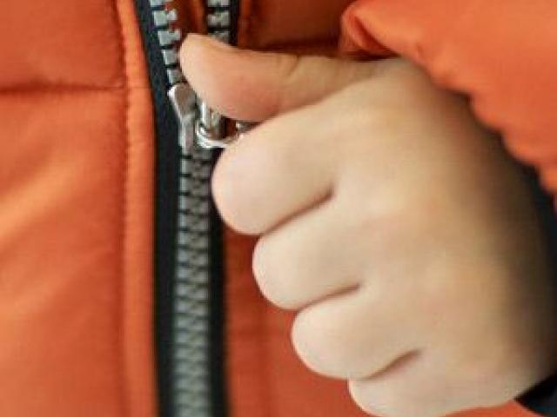
School Readiness
Our website has some resources to support you and your child with school readiness.

Slide 9
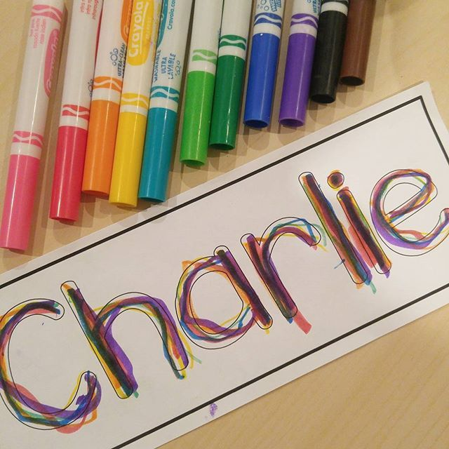
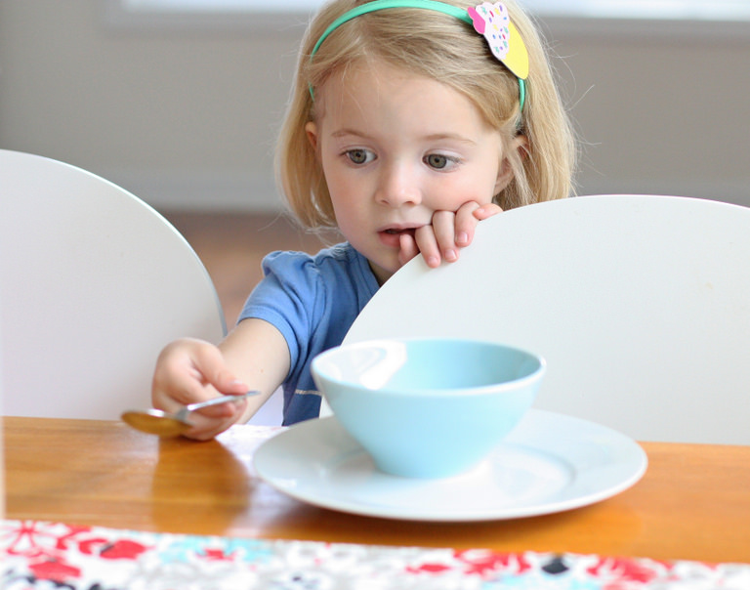
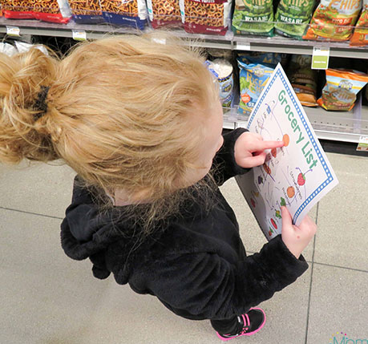
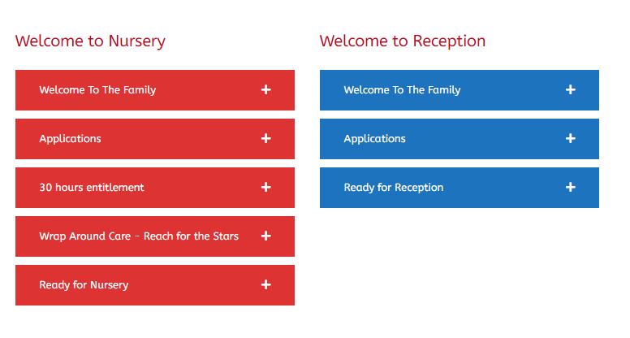
Helping at home…

Slide 10
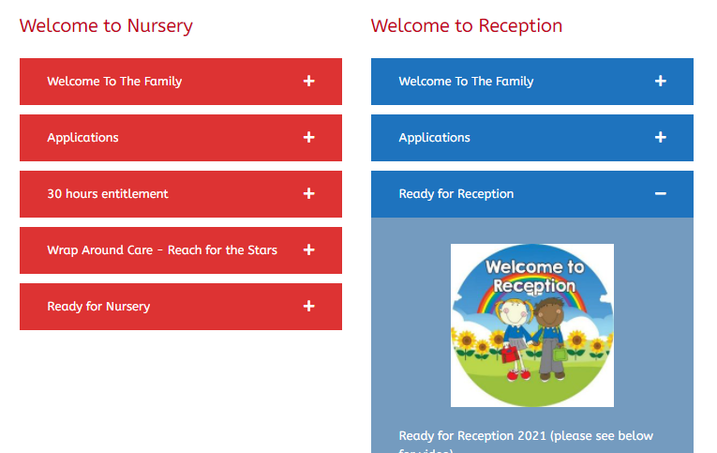
Ready for Reception/ Nursery 2021
Please see –
School website
Parents
Admissions
Ready for Reception/ Ready for Nursery

Slide 11
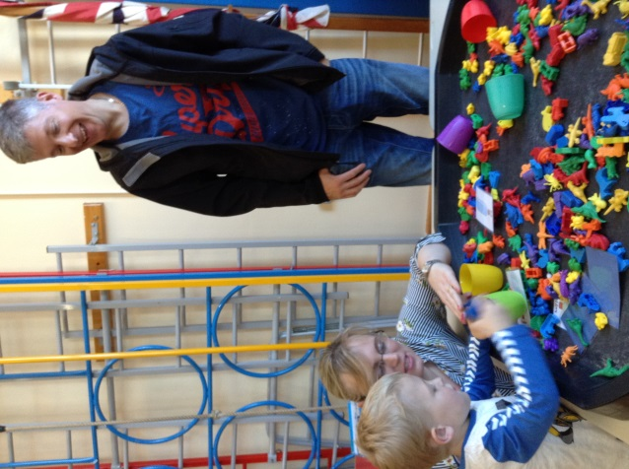
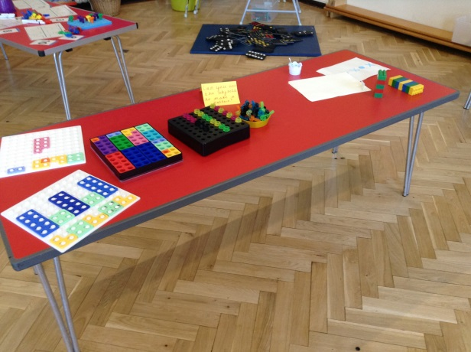
Parent Workshops
Mind the Gap!– Language and communication workshop – October 12th 2:15pm
1,2,3,4,5 Once I caught a fish alive!
Maths in the Early Years date TBC
Read it all about! Phonics/
Reading – 30th September 2:15pm

Slide 12
When children are not making the expected progress.
Individual or small groups in class
Intervention
Tailored for your child.
Parents will be kept informed and activities might be sent home
Tailored for your child.
Activities are planned and delivered by a member of staff

Slide 13
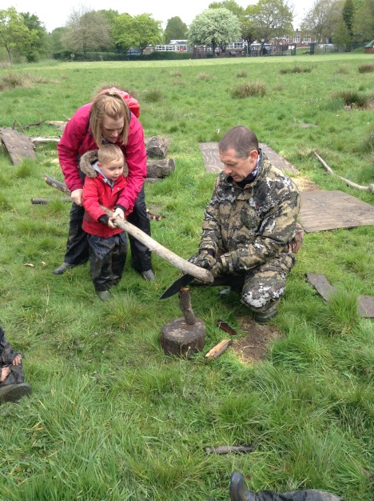
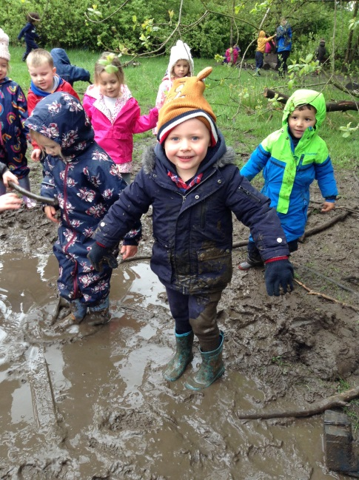
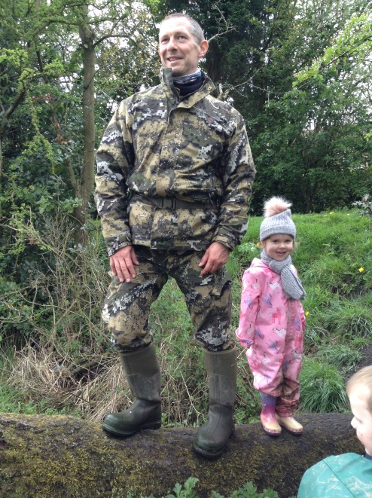
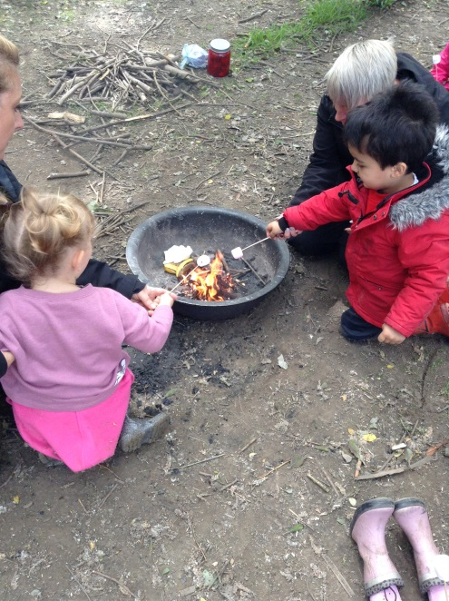
FOREST SCHOOL
This is run by a specialist forest school leader Mr Fox.
This will run in the Spring Term for EYFS
All parents will be invited to share the final forest school experience with the children.

Slide 14
Swimming!
When will my child swim?
Nursery TBC
Reception Wednesday AM
What will they need?
Adults at swimming.

Slide 15
Home / School Links
Text messaging service (app reminder)
Labels and comments in home / school books.
Opportunities for you to join us in the classroom
Evidence Me
Drop in –on Thursday 3.15pm – 4.00pm (BB) Wednesday (CC)
Parents Evenings termly
Termly Progress reports
Email System:
homeworkbb@knypersley.staffs.sch.uk
homeworkcc@knypersley.staffs.sch.uk
homeworknurs@knypersley.staffs.sch.uk

Slide 16
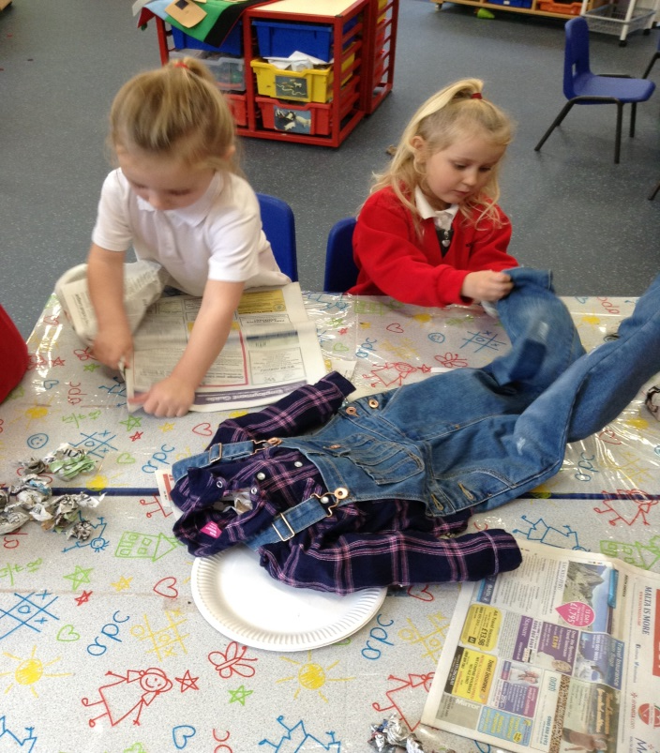
Evidence Me
What is this?
Why do we use it?
Can I use this too?
Frequently asked questions.
EE
“Today we made a scarecrow using straw. We sang Dingle Dangle Scarecrow together!”

Slide 17
Wow Moments!
We value any contribution that you would like to make to this in helping us meet your child’s needs.
‘WOW Moments’ Balloon templates will come home for you to record new learning!
Evidence Me – Parent Postcards can be added to your child’s profile to support their next steps

Slide 18
@KnypersleyFirst

Slide 19
Reception Check List
Water bottles in school everyday.
Juice / milk money to be paid on a Friday for the coming week or termly.
Children will be offered free fruit daily and milk
For an additional £1.50 weekly children will also be offered a healthy snack and juice
Swimming – Wednesday morning for both classes (see rota on web page)
PE – Tuesday for both classes.
Please name all items of clothing.
Homework menus will be uploaded on to the class webpage
Class trips will take place during the year. There is often a cost but we keep this to a minimum.

Slide 20
Nursery Check List
Water bottles in school everyday.
Juice money to be paid on a Friday for the coming week or termly.
Swimming – More information to follow via dates
Please name all items of clothing.
PE day – Tuesday please send children in wearing PE kit
Class Phone ins – Thursday for both classes 3.15pm – 4.00pm
Please make sure your child comes to school with appropriate clothing for the outdoor weather.
Homework menus will be on the class webpage
Accidents do happen so please send in a change of clothes with your child daily.
01782 973810

Slide 21
We are very much looking forward to meeting you all soon!

