Slide 2
Ready to Rock
Starry-Eyed Stan and his rocking band are getting ready for their first concert.

Slide 3
Ready to Rock
Pam the pufferfish needs a new saxophone for the concert.
She has spotted an advert about a really great saxophone!

Slide 4
Persuasive Posters
Super Saxophone for Sale
Have you ever dreamed of owning the world’s best saxophone?
The Saxophone 6000 is an incredible instrument.
It will amaze you with its soulful sounds.
Buy the Saxophone 6000 today.
What a magnificent musician you will be!
Only £299.99.
Visit www.supersax6000.twin.kl
or call 0123 465 798 to buy.
Stocks won’t last long. Buy one now.
Let’s read the poster together.
What do you think the poster is trying to tell us or make us do?

Slide 5
Persuasive Posters
Super Saxophone for Sale
Have you ever dreamed of owning the world’s best saxophone?
The Saxophone 6000 is an incredible instrument.
It will amaze you with its soulful sounds.
Buy the Saxophone 6000 today.
What a magnificent musician you will be!
Only £299.99.
Visit www.supersax6000.twin.kl
or call 0123 465 798 to buy.
Stocks won’t last long. Buy one now.
The poster is using different types of sentences to persuade us to buy a saxophone.

Slide 6
Types of Sentences
Statements
Statements are sentences which tell you something, like a fact. They should contain a verb, a noun and usually end with a full stop.
Starfish live in the sea.
In a persuasive poster, the statement might tell the reader how brilliant something is.
Starfish are truly excellent animals.

Slide 7
Types of Sentences
Questions
Questions are sentences that ask you something. They usually end with a question mark.
What is your favourite sea creature?
A persuasive poster might ask a question that sounds like we should give one obvious answer, usually yes or no.
Would you like to go on an amazing fun trip to the beach?

Slide 8
Types of Sentences
Commands
Commands are sentences that tell you to do something. They are found in instructions and start with an imperative verb (bossy word).
Play me a song.
In a persuasive poster, the command might be telling us to do or buy something.
Visit the seaside today.

Slide 9
Types of Sentences
Exclamations
An exclamation is a sentence beginning with ‘What’ or ‘How’. It is a full sentence, including a verb, which ends with an exclamation mark.
What an amazing band they are!
In a persuasive poster, the exclamation sentence might be used to make it seem like the writer truly thinks something is amazing.
What a sensational singer he was!
How special it is to hear him sing!

Slide 10
Types of Sentences
Super Saxophone for Sale
Can you spot the different types of sentences in the poster?
Statement
Question
Command
Exclamation
Talk to your partner.
Have you ever dreamed of owning the world’s best saxophone?
The Saxophone 6000 is an incredible instrument.
It will amaze you with its soulful sounds.
Buy the Saxophone 6000 today.
What a magnificent musician you will be!
Only £299.99.
Visit www.supersax6000.twin.kl
or call 0123 465 798 to buy.
Stocks won’t last long. Buy one now.

Slide 11
Types of Sentences
Super Saxophone for Sale
Question
Have you ever dreamed of owning the world’s best saxophone?
The Saxophone 6000 is an incredible instrument.
It will amaze you with its soulful sounds.
Buy the Saxophone 6000 today.
What a magnificent musician you will be!
Only £299.99.
Visit www.supersax6000.twin.kl
or call 0123 465 798 to buy.
Stocks won’t last long. Buy one now.
Statement
Statement
Command
Exclamation
Command
Statement
Command

Slide 12
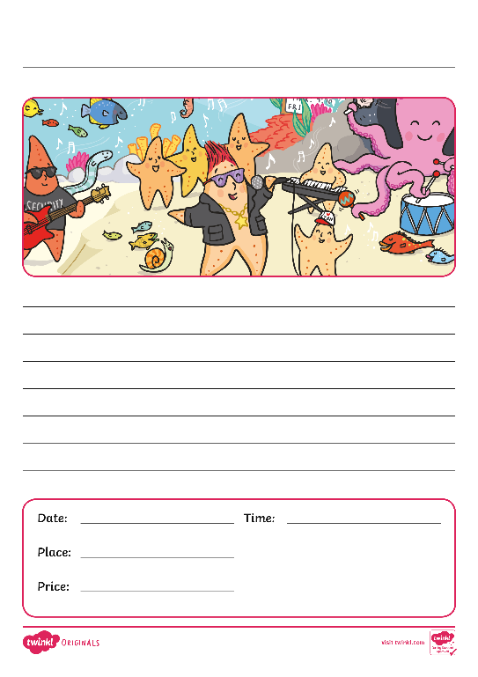
Convince Your Customers
Stan and his band need you to advertise their concert.
Create a persuasive poster that includes these different sentence types:
Statement
Question
Command
Exclamation
Can you include one of each?
Include these details:
Date
Time
Place
Price
Website or phone number
Remember, your poster needs to make the concert sound amazing so that people buy tickets!

Slide 13
Convince Your Customers
Try reading your poster aloud.
Can you read your persuasive poster clearly?
Can you read the different sentence types correctly?
Does a question sound the same as a statement?

