Slide 1
Segment and blend!

Slide 2
cat

Slide 3
cat

Slide 4
cat

Slide 5
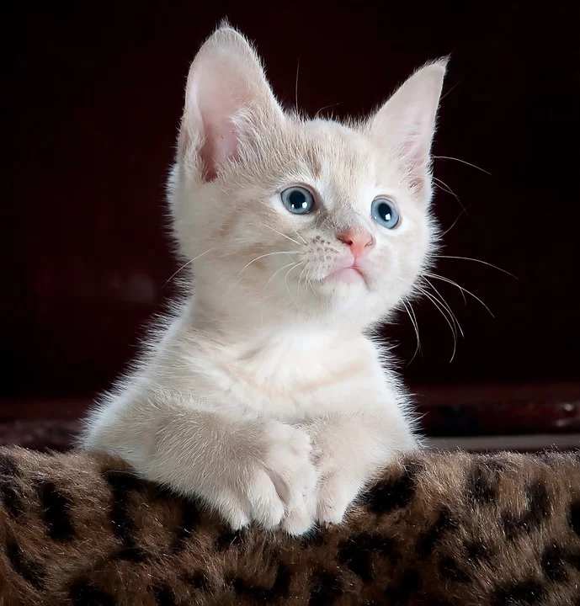
cat

Slide 6
peg

Slide 7
peg

Slide 8
peg

Slide 9
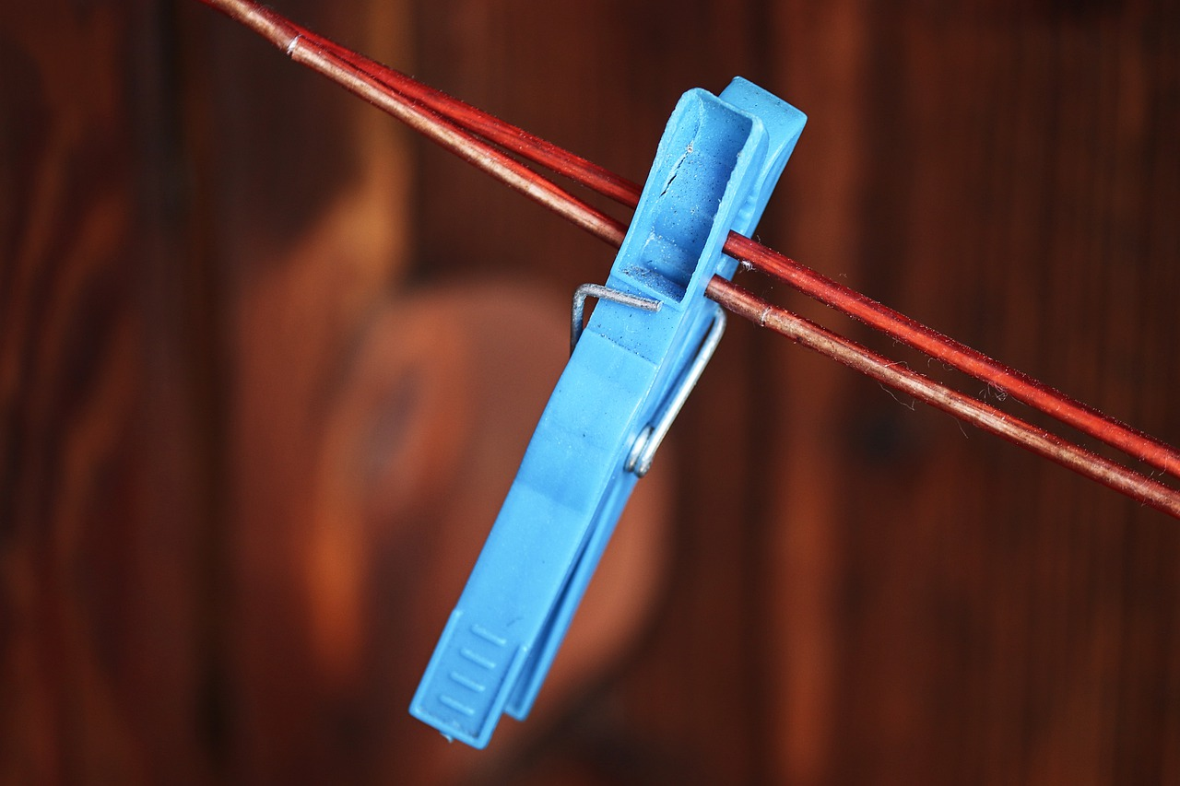
peg

Slide 10
bat

Slide 11
bat

Slide 12
bat

Slide 13
bat

Slide 14
sit

Slide 15
sit

Slide 16
sit

Slide 17
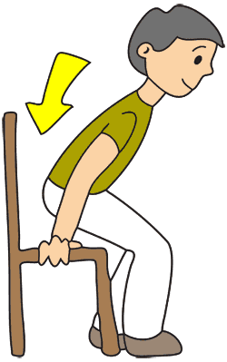
sit

Slide 18
tap

Slide 19
tap

Slide 20
tap

Slide 21
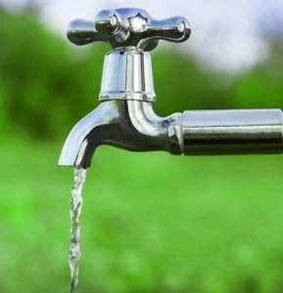
tap

Slide 22
pan

Slide 23
pan

Slide 24
pan

Slide 25
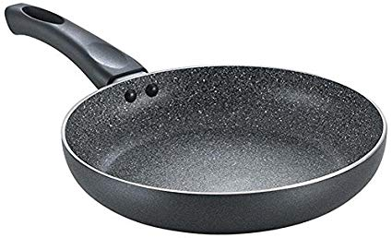
pan

Slide 26
map

Slide 27
map

Slide 28
map

Slide 29
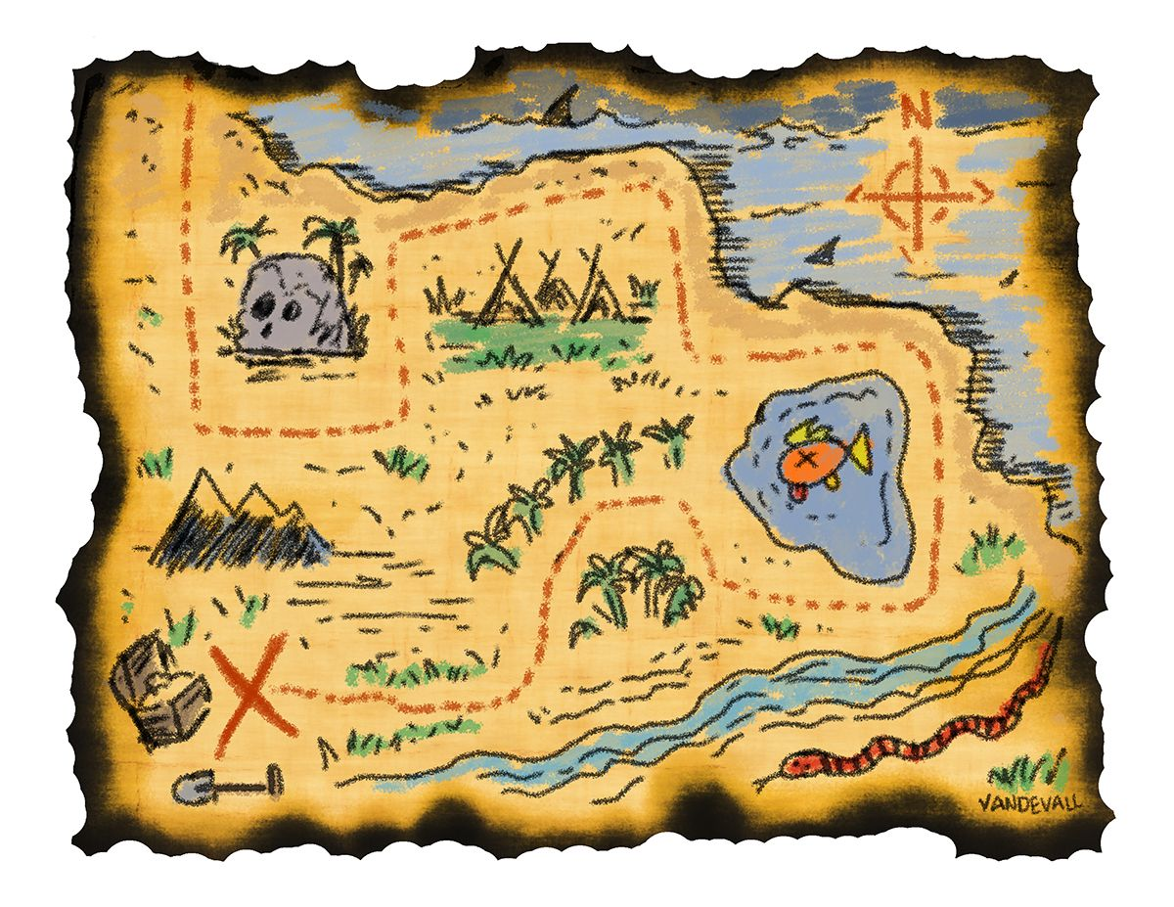
map

Slide 30
mat

Slide 31
mat

Slide 32
mat

Slide 33
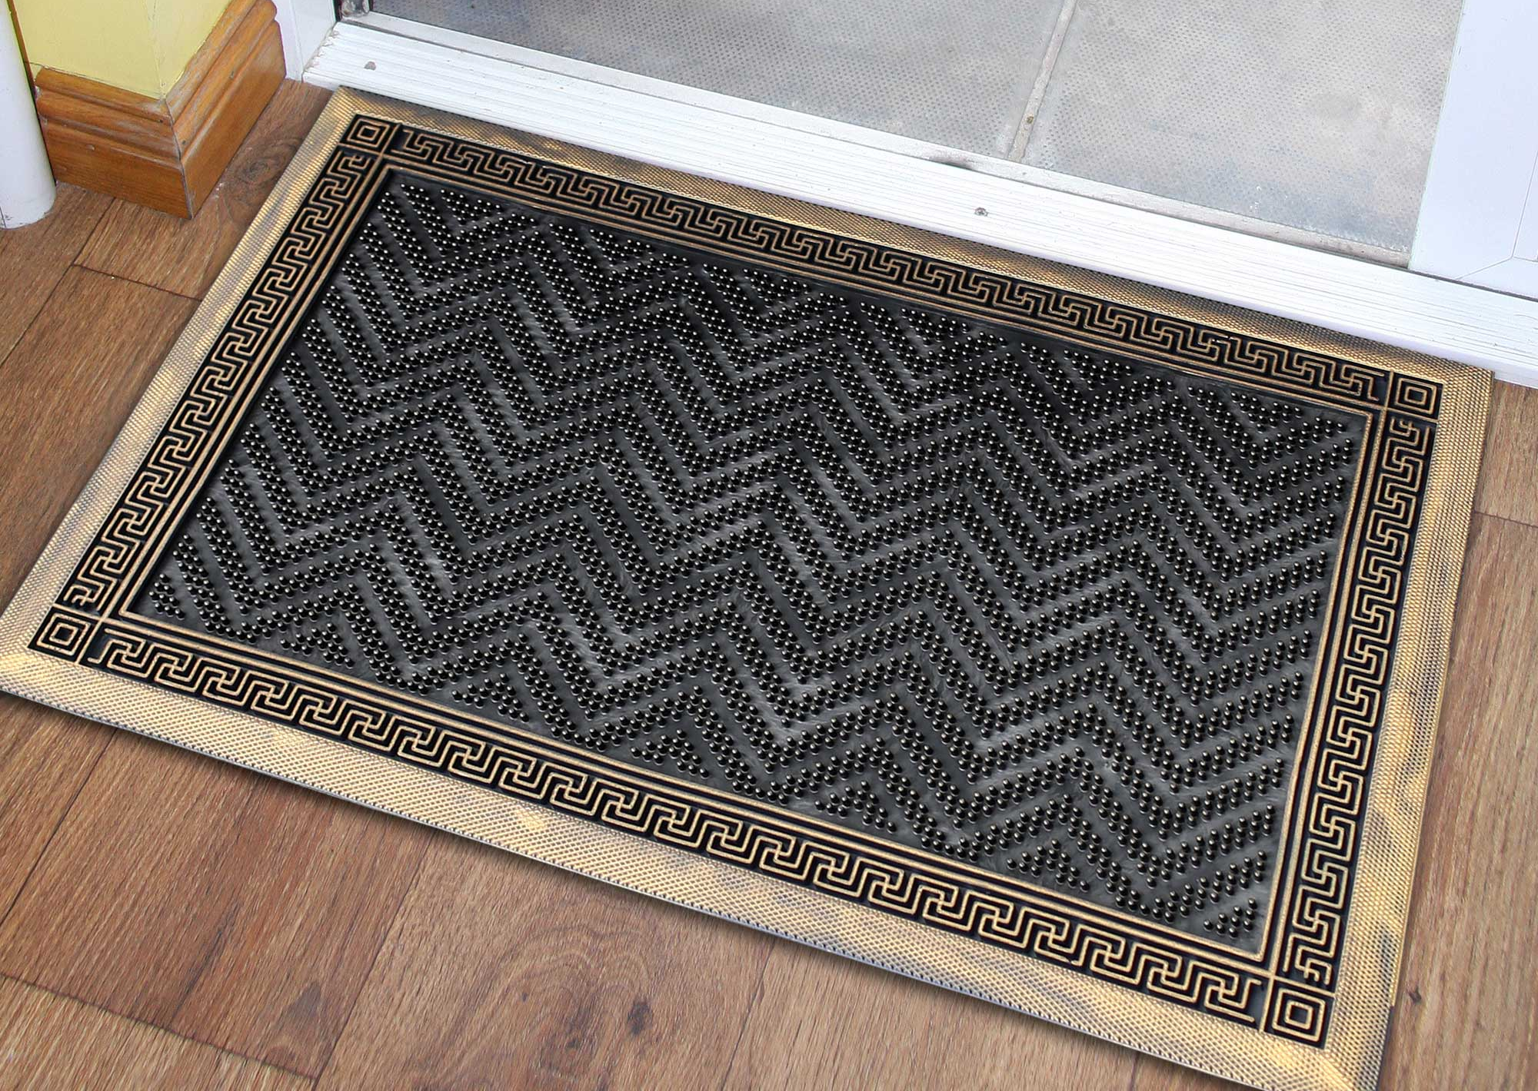
mat

Slide 34
jam

Slide 35
jam

Slide 36
jam

Slide 37
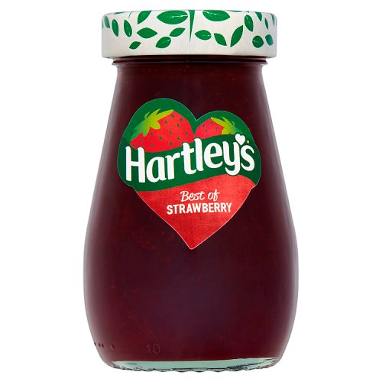
jam

Slide 38
bed

Slide 39
bed

Slide 40
bed

Slide 41
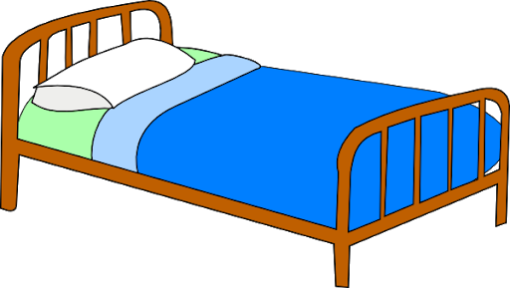
bed

Slide 42
dig

Slide 43
dig

Slide 44
dig

Slide 45
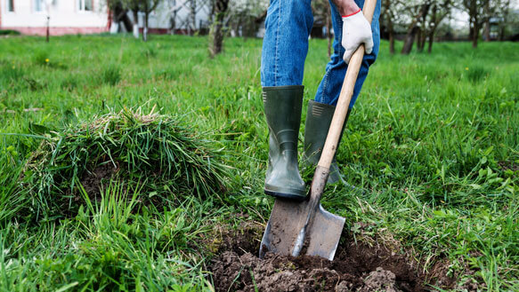
dig

Slide 46
ten

Slide 47
ten

Slide 48
ten

Slide 49
ten

Slide 50
van

Slide 51
van

Slide 52
van

Slide 53
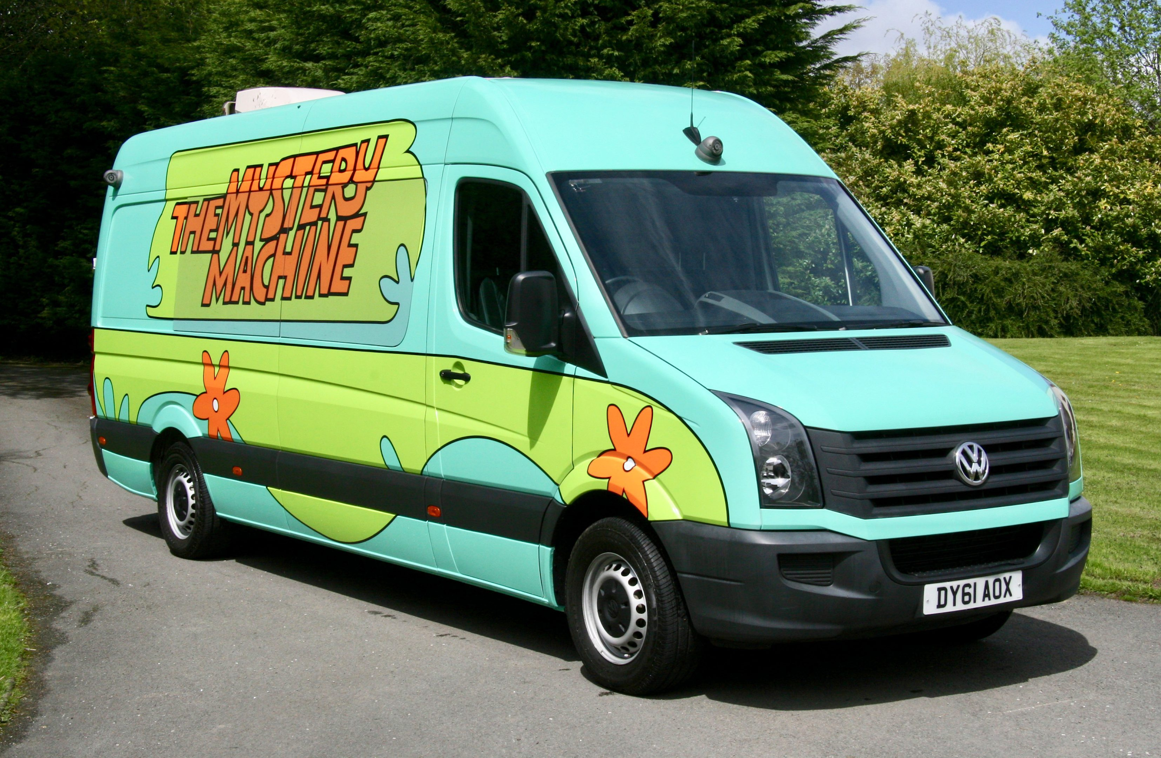
van

Slide 54
red

Slide 55
red

Slide 56
red

Slide 57
red

Slide 58
pen

Slide 59
pen

Slide 60
pen

Slide 61
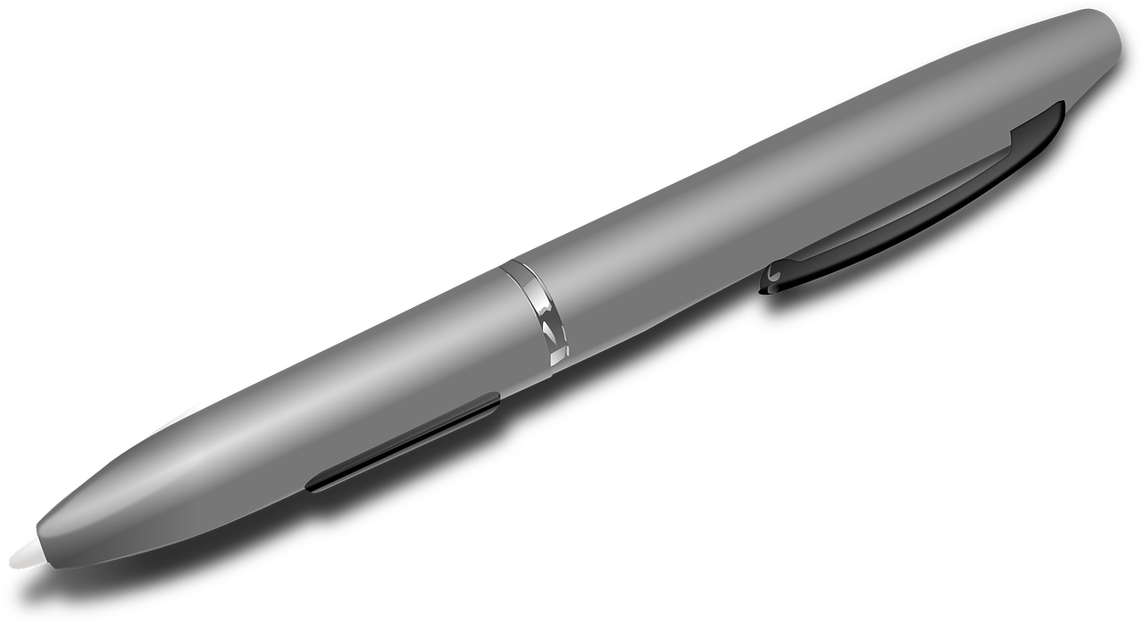
pen

Slide 62
hen

Slide 63
hen

Slide 64
hen

Slide 65
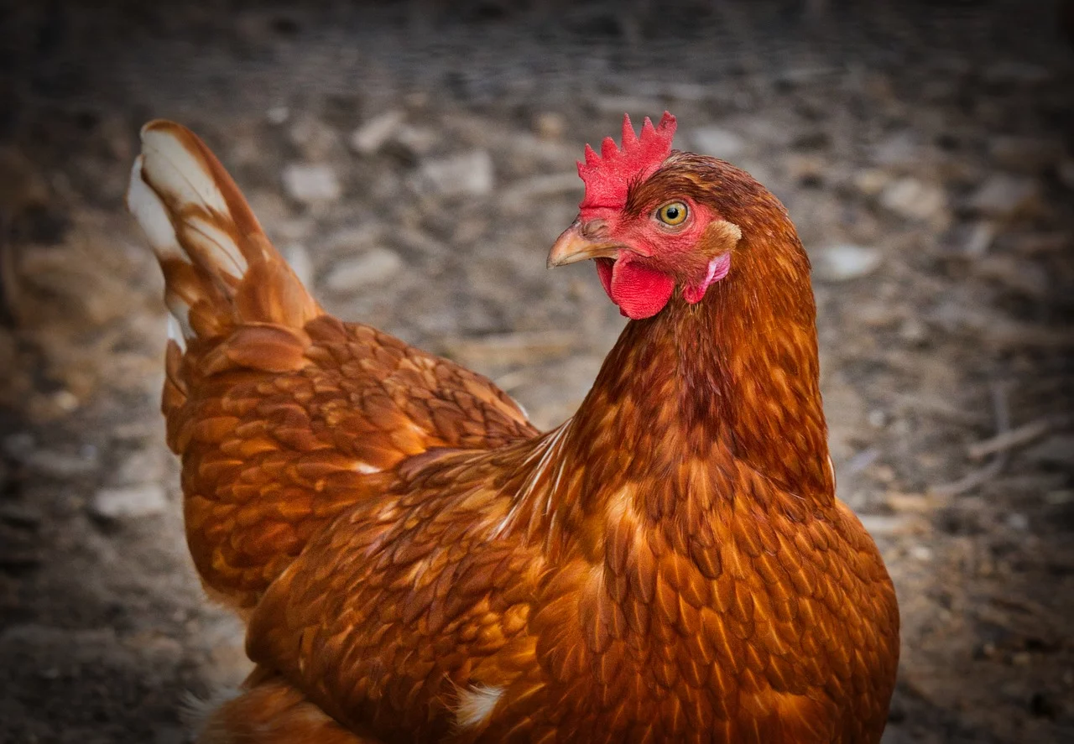
hen

Slide 66
web

Slide 67
web

Slide 68
web

Slide 69
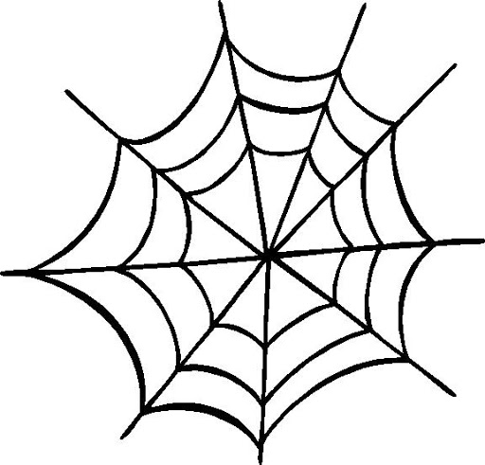
web

Slide 70
wig

Slide 71
wig

Slide 72
wig

Slide 73
wig

Slide 74
pig

Slide 75
pig

Slide 76
pig

Slide 77
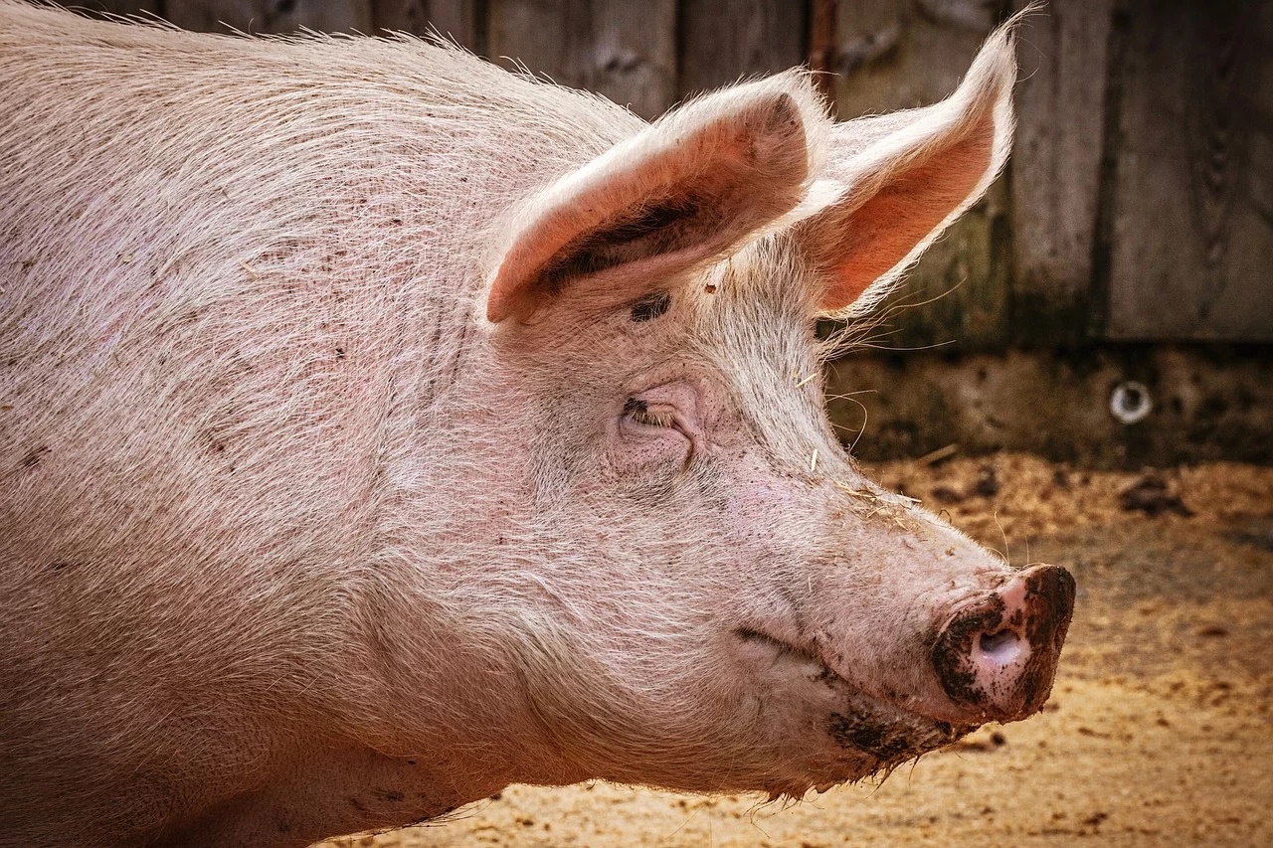
pig

Slide 78
zip

Slide 79
zip

Slide 80
zip

Slide 81
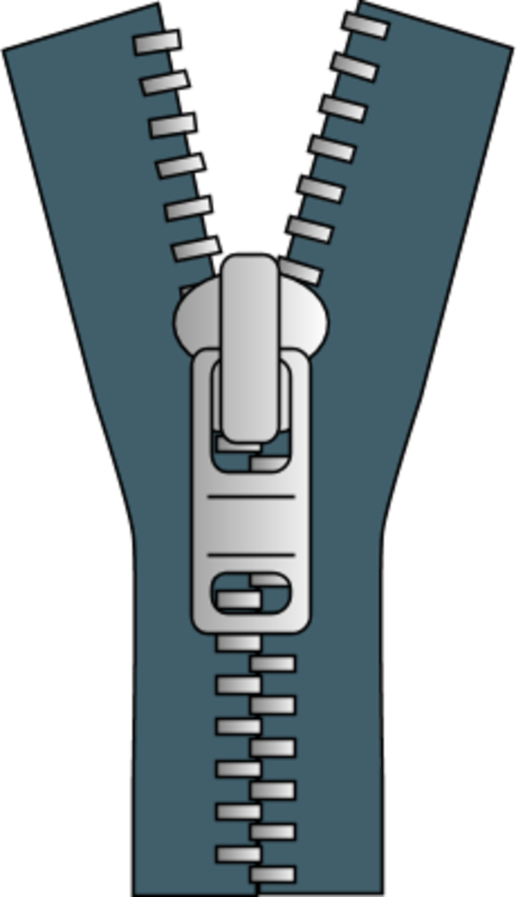
zip

Slide 82
sun

Slide 83
sun

Slide 84
sun

Slide 85
sun

Slide 86
bus

Slide 87
bus

Slide 88
bus

Slide 89
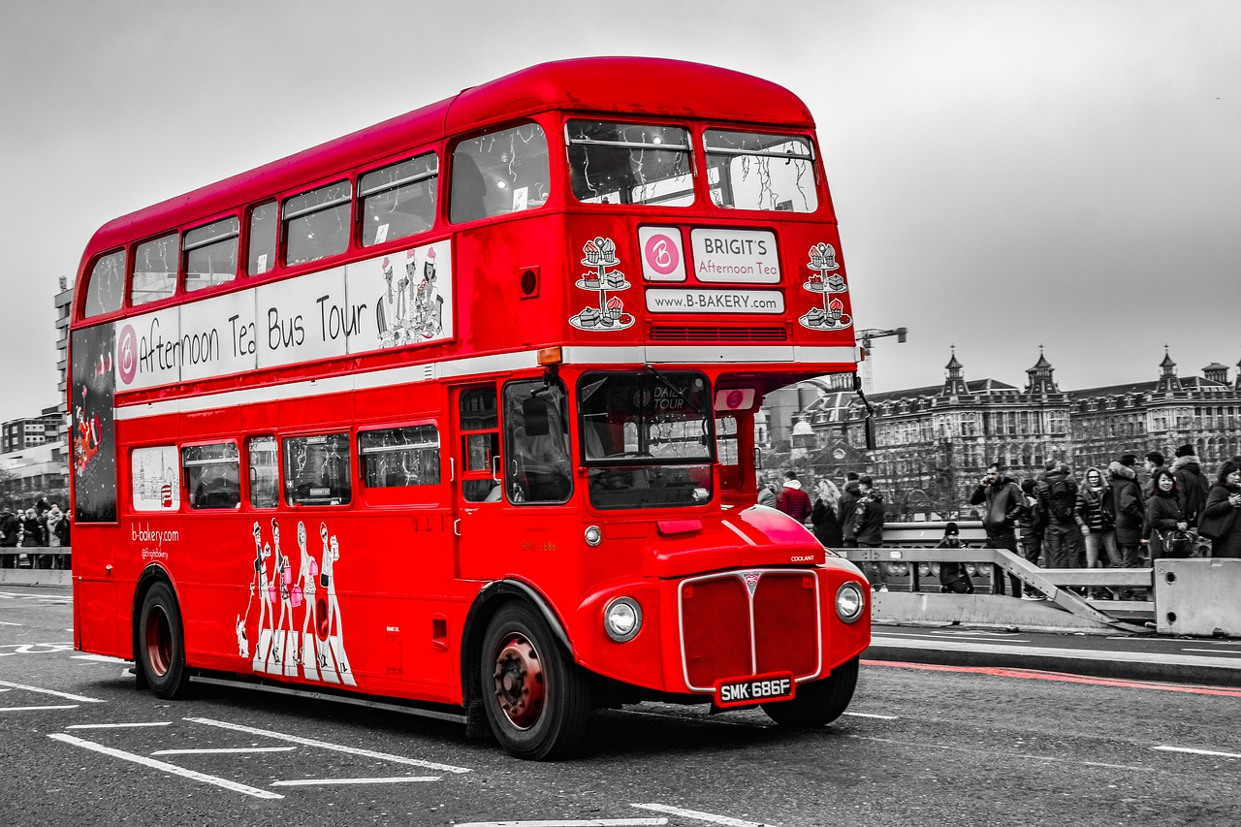
bus

Slide 90
run

Slide 91
run

Slide 92
run

Slide 93
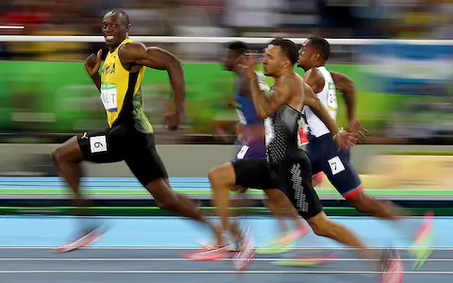
run

Slide 94
jug

Slide 95
jug

Slide 96
jug

Slide 97
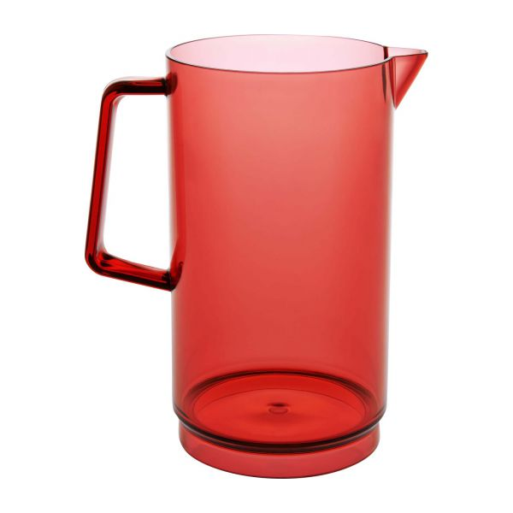
jug

Slide 98
six

Slide 99
six

Slide 100
six

Slide 101
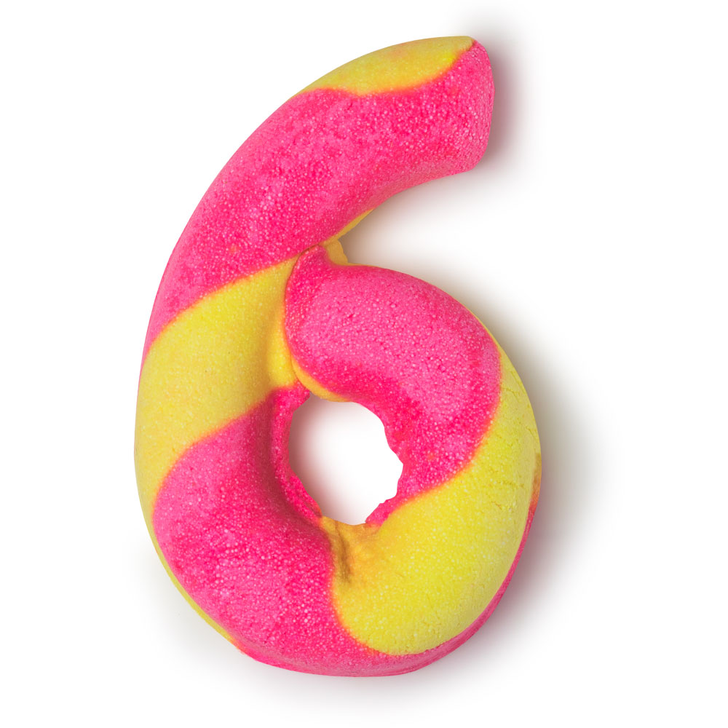
six

Slide 102
box

Slide 103
box

Slide 104
box

Slide 105
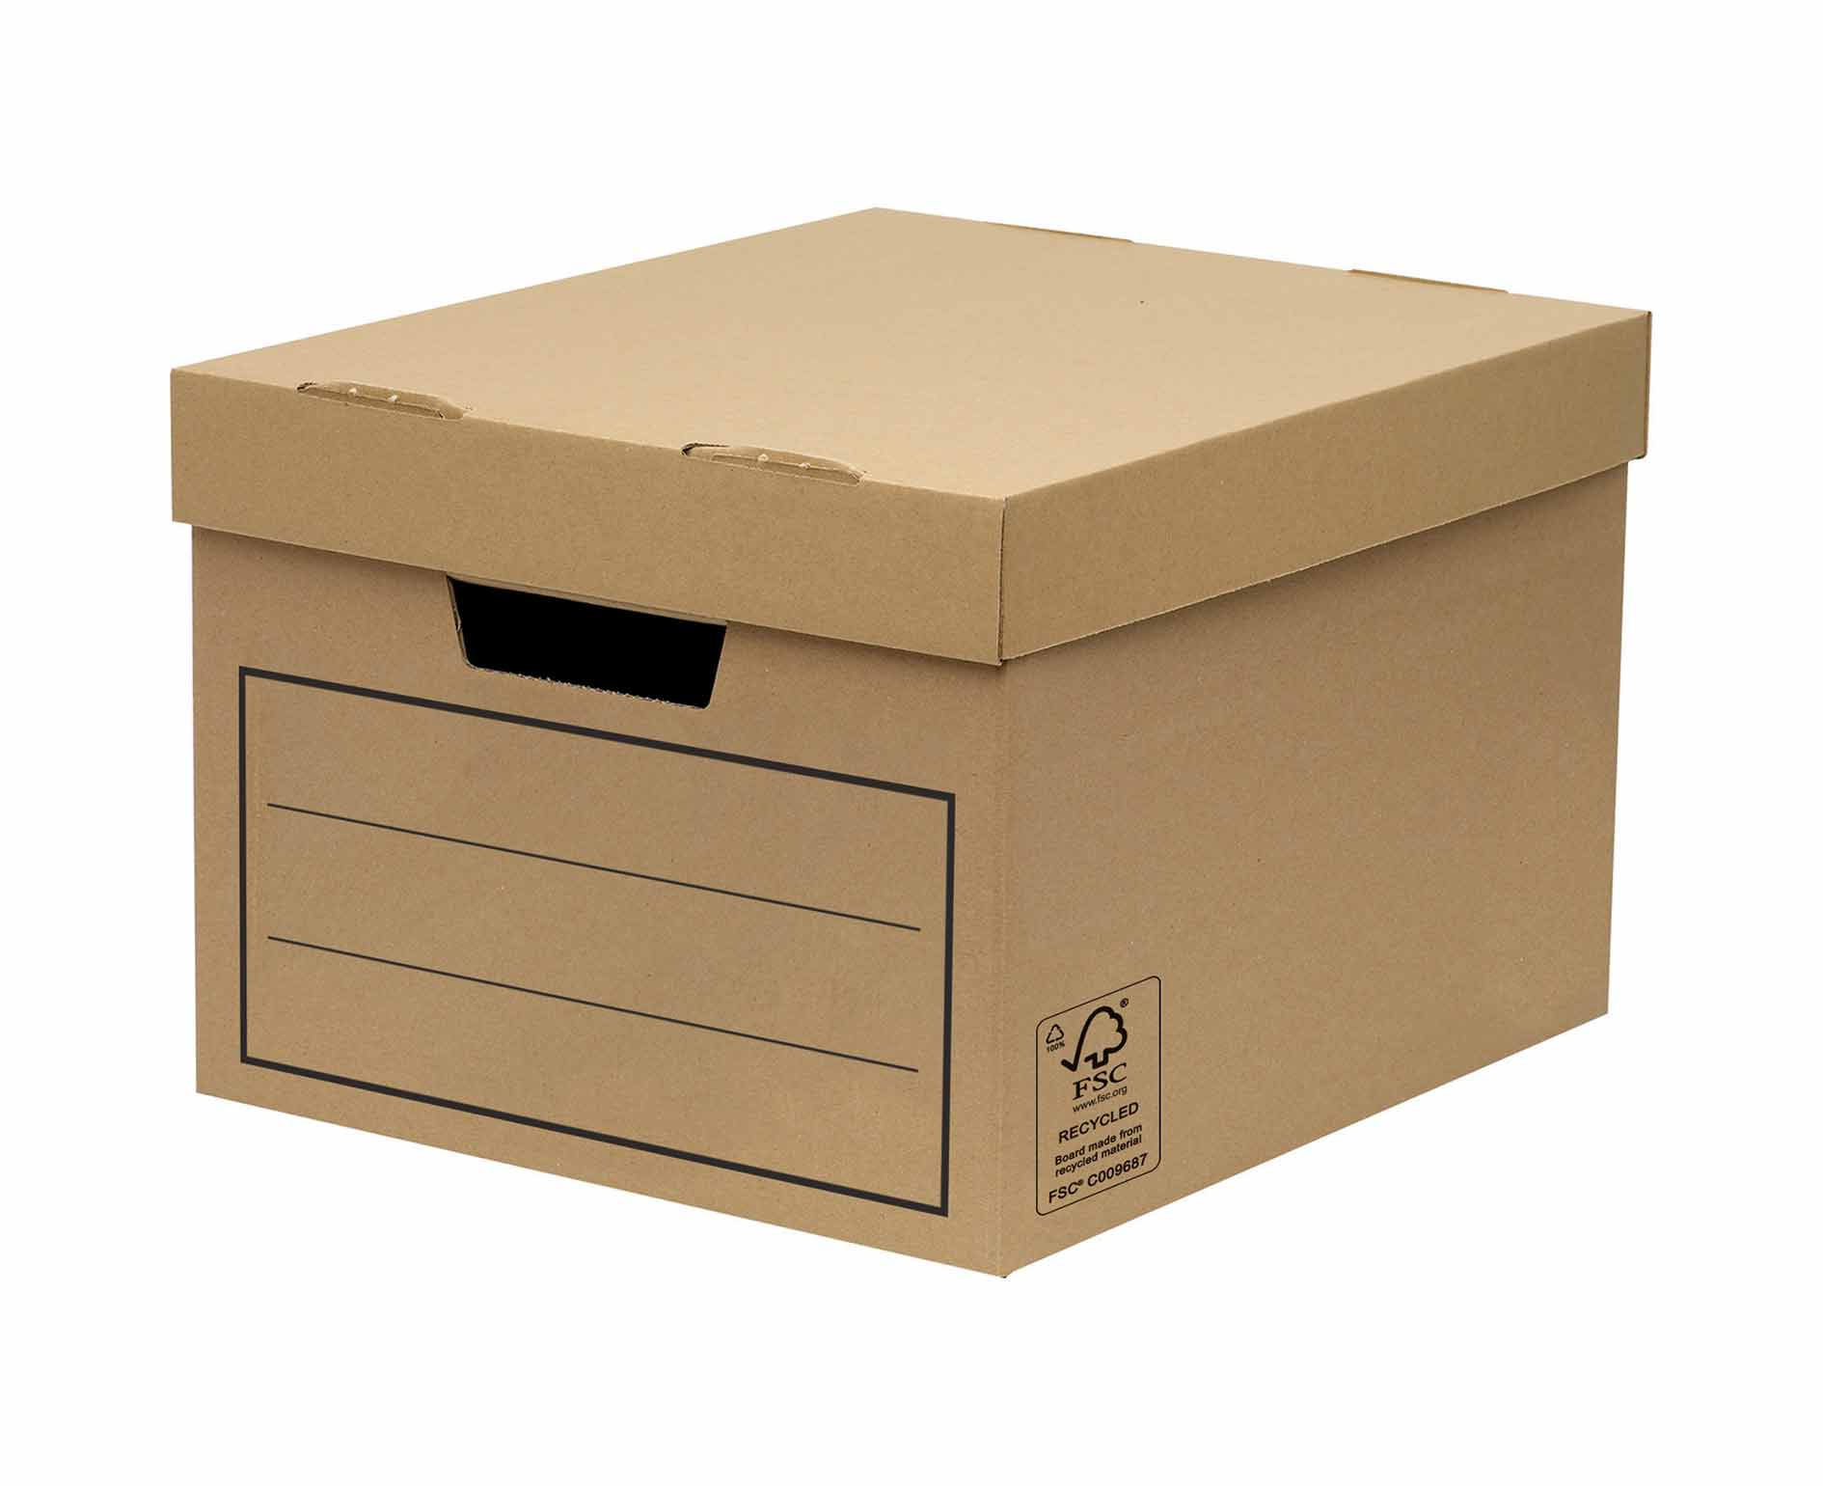
box

Slide 106
fox

Slide 107
fox

Slide 108
fox

Slide 109
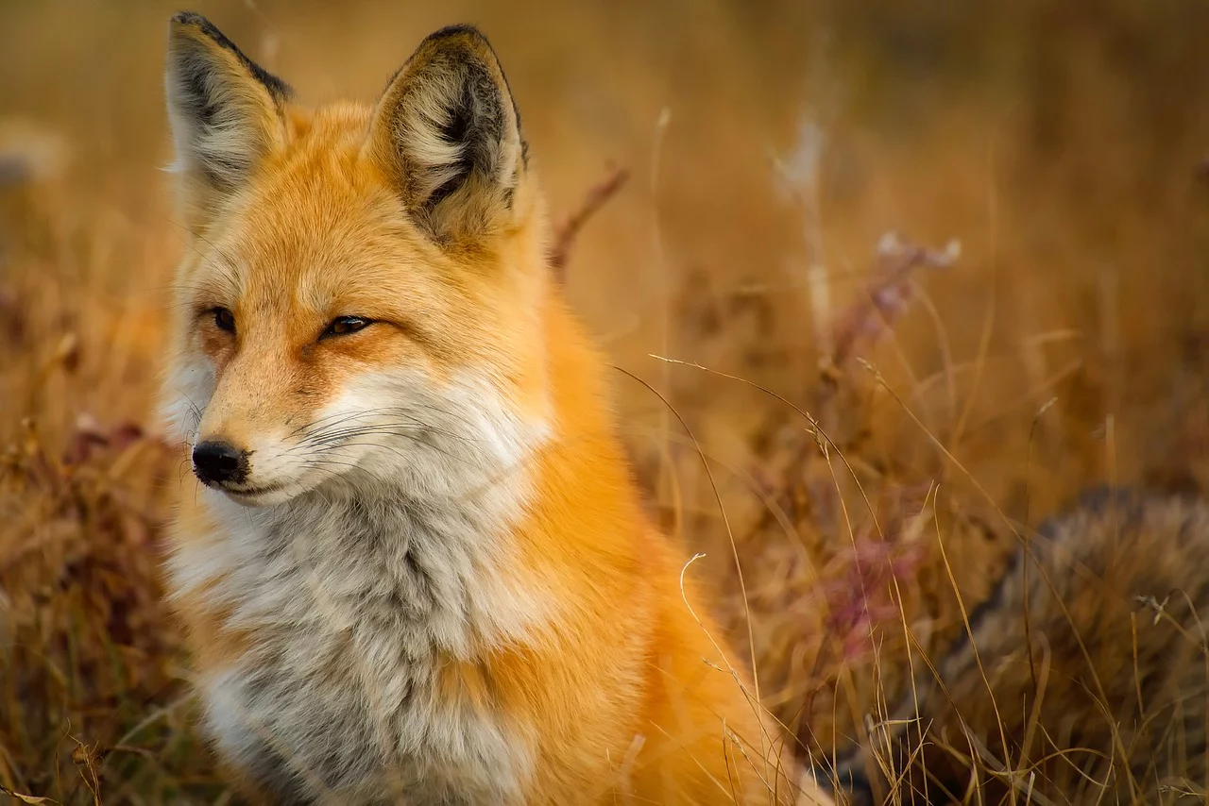
fox

Slide 110
mix

Slide 111
mix

Slide 112
mix

Slide 113
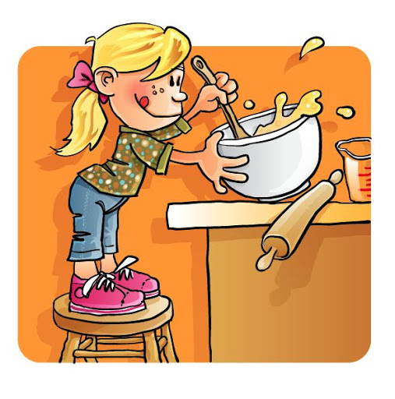
mix

Slide 114
Twix

Slide 115
Twix

Slide 116
Twix

Slide 117
Twix

Slide 118
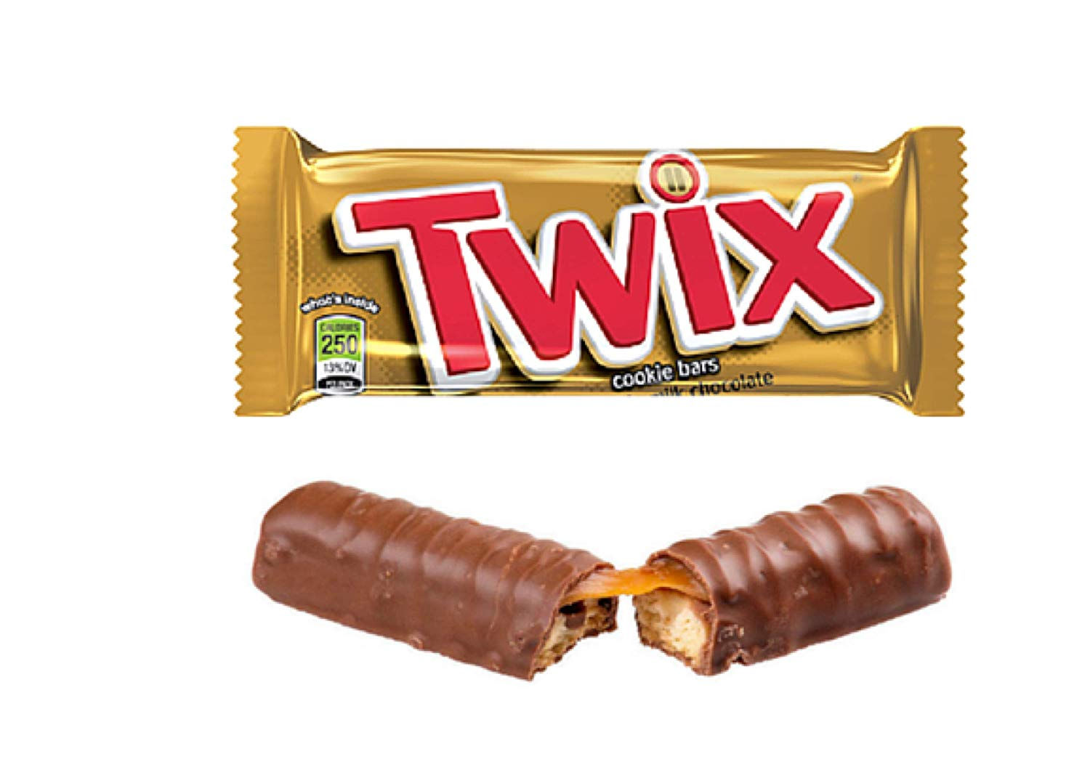
Twix

Slide 119
Buzz

Slide 120
Buzz

Slide 121
Buzz

Slide 122
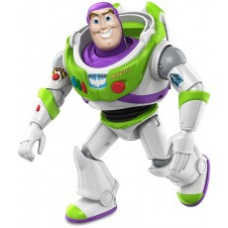
Buzz

Slide 123
frog

Slide 124
frog

Slide 125
frog

Slide 126
frog

Slide 127
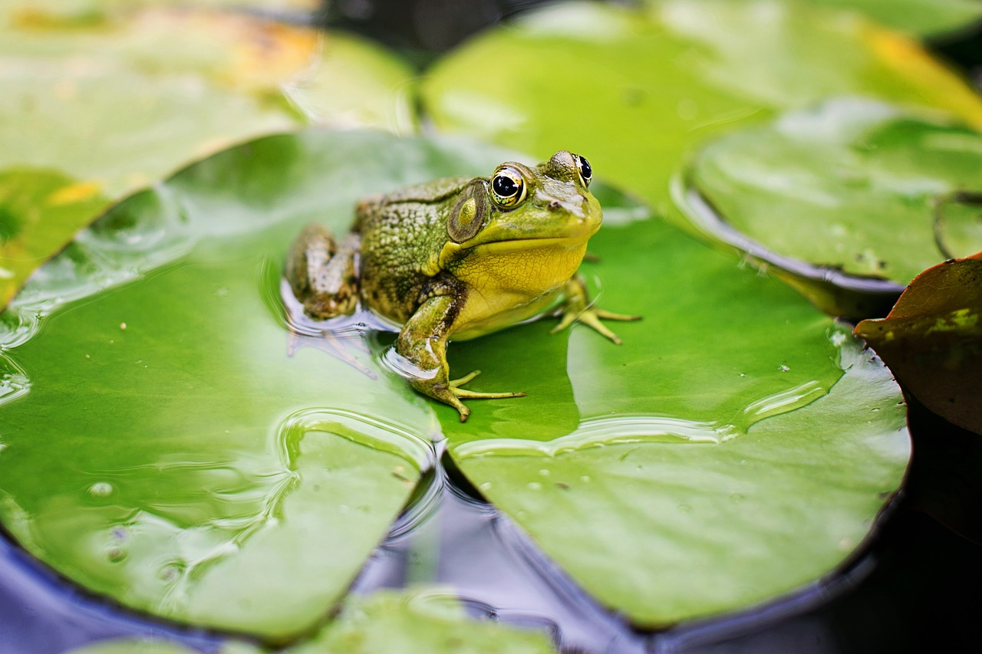
frog

Slide 128
stop

Slide 129
stop

Slide 130
stop

Slide 131
stop

Slide 132
stop

Slide 133
drip

Slide 134
drip

Slide 135
drip

Slide 136
drip

Slide 137
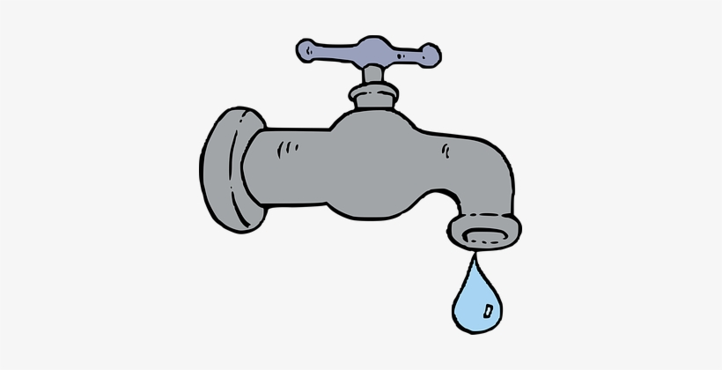
drip

Slide 138
crab

Slide 139
crab

Slide 140
crab

Slide 141
crab

Slide 142
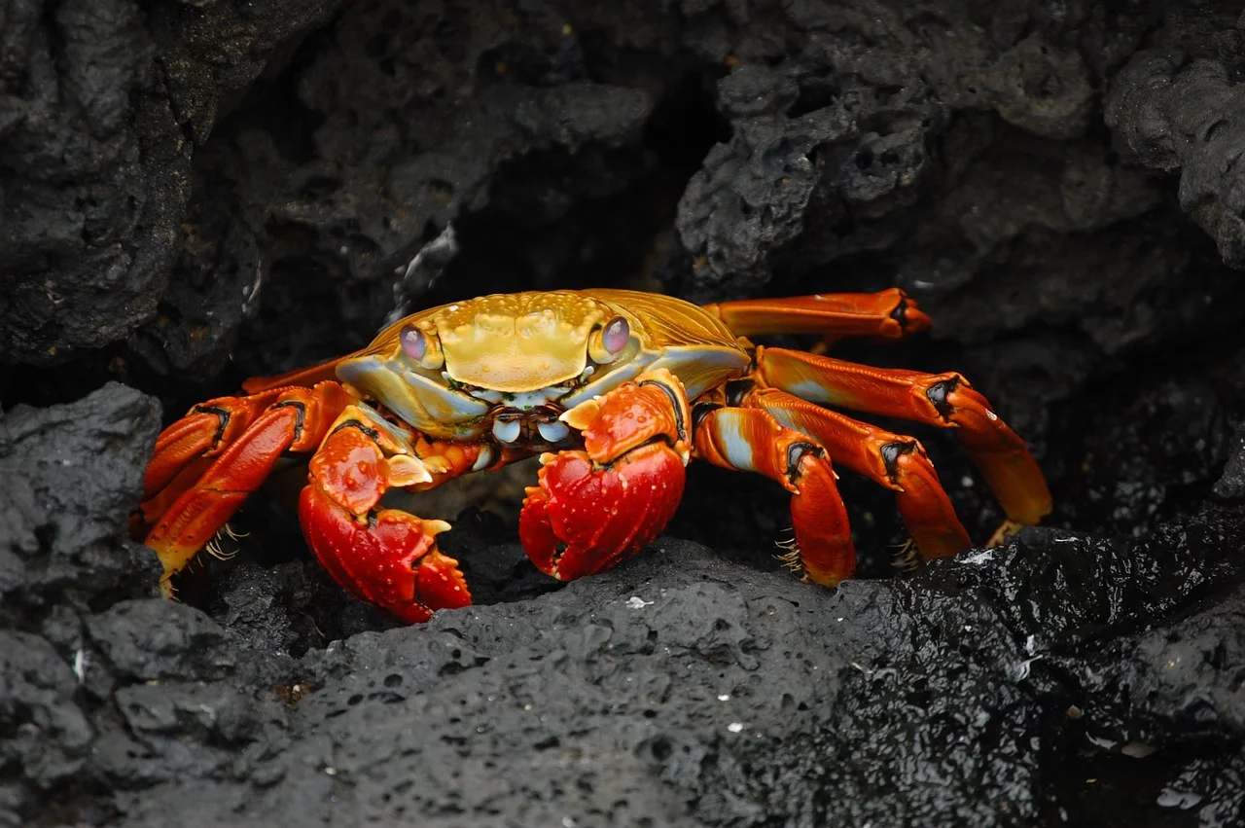
crab

Slide 143
sand

Slide 144
sand

Slide 145
sand

Slide 146
sand

Slide 147
sand

Slide 148
hand

Slide 149
hand

Slide 150
hand

Slide 151
hand

Slide 152
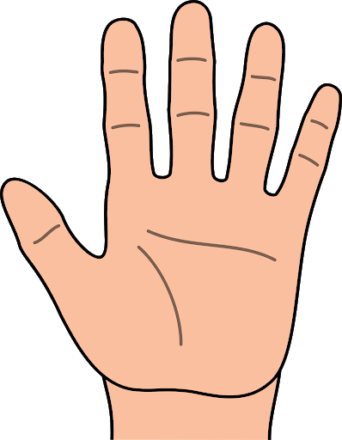
hand

Slide 153
drum

Slide 154
drum

Slide 155
drum

Slide 156
drum

Slide 157
drum

Slide 158
swim

Slide 159
swim

Slide 160
swim

Slide 161
swim

Slide 162
swim

Slide 163
cliff

Slide 164
cliff

Slide 165
cliff

Slide 166
cliff

Slide 167
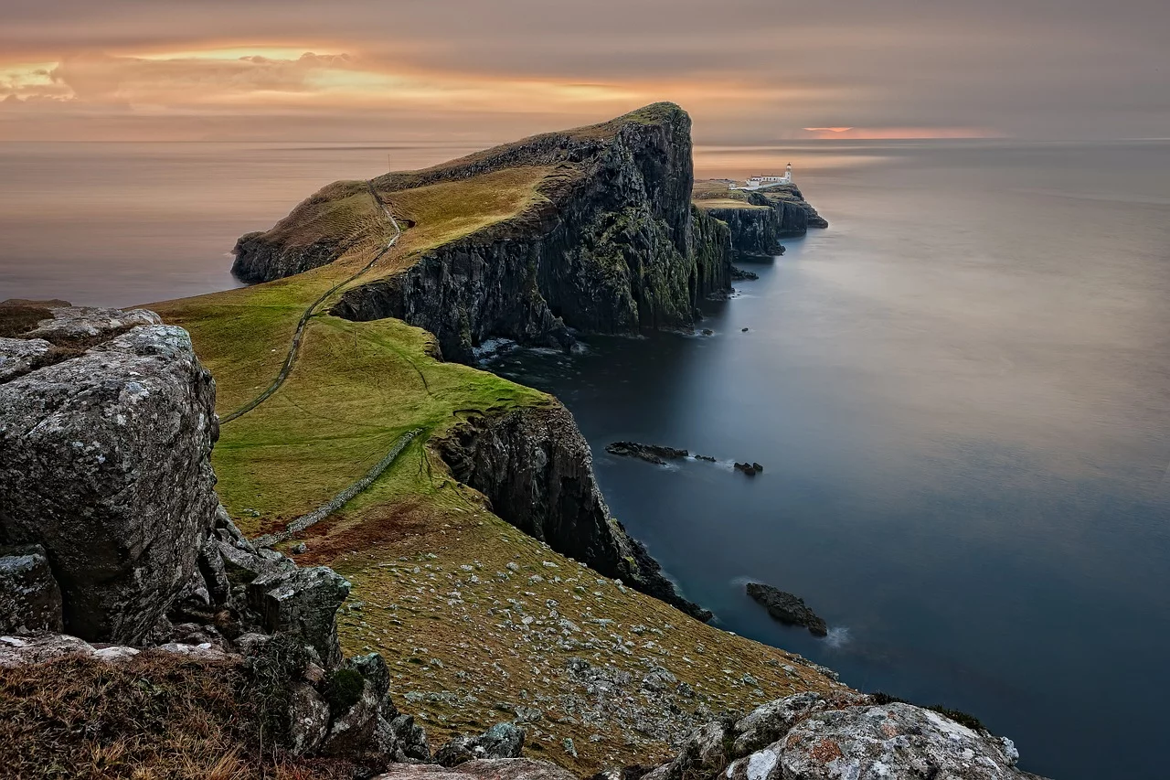
cliff

Slide 168
muffin

Slide 169
muffin

Slide 170
muffin

Slide 171
muffin

Slide 172
muffin

Slide 173
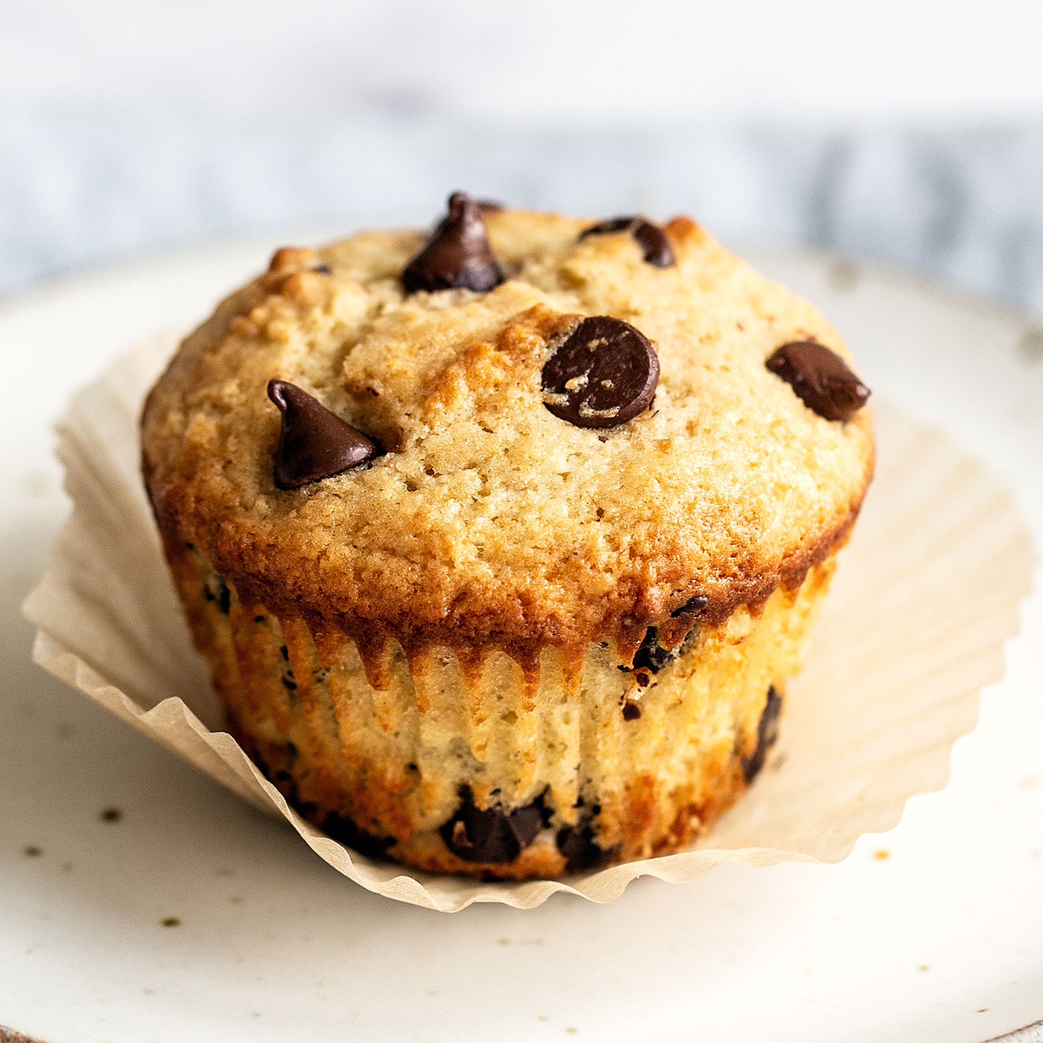
muffin

Slide 174
spell

Slide 175
spell

Slide 176
spell

Slide 177
spell

Slide 178
spell

