Slide 1
Help your children to be e-safe!

Slide 5
Why is Tuesday 5th January important?
5th February is Safer Internet day.
So why is it important to be safe on the internet?

Slide 6
Why is this important?
In a survey of 825 adults and children between the ages of seven and 16, Shared Hope International found one out of eight parents allowed their children to use the internet from the age of two.
Only, one out of 10 make their children wait until they are 10 or older.

Slide 7
Why is this important?
Many children are using the internet unsupervised at an early age.
Studies found that over 71 percent of parents do not supervise their children's internet use after the age of 14, yet a shocking 72 percent of all missing children cases that begin online involve children who are 15 or older.

Slide 8
Why is this important?
Kidsafe Foundation reports nearly 32 percent of teenagers hide or delete their browsing history from their parents.
Likewise, 16 percent of teens have email or social media accounts their parents are unaware of.
Often, children even lie about their ages in order to create such accounts, attracting attention from older children or even adults.

Slide 9
Why is this important?
The National Center for Missing and Exploited Children (NCMEC) reports 15 percent of children between ages 10 and 17 have been contacted via the internet for sexual intent.

Slide 10
Why is this important?
Often, teenagers and sometimes even adults are Facebook friends and have conversations online with individuals they have never met in person. Teenagers are trusting - often willing to meet with strangers.
A recent study found 16 percent of teenagers have simply considered meeting someone they have conversed with online, and 8 percent have actually physically met with someone.

Slide 11
When do you need to be e-safe?

Slide 12
When do you need to be e-safe?

Slide 13
When do you need to be e-safe?

Slide 14
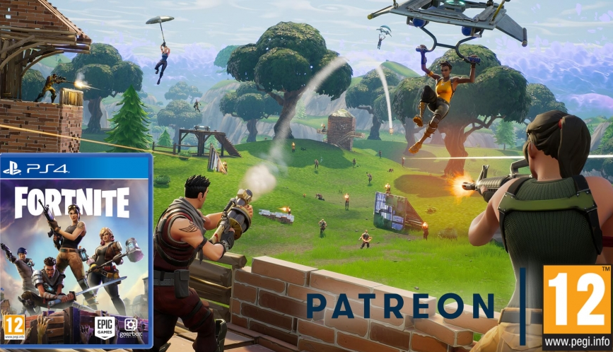

Slide 15
How can we be e-safe?
www.askaboutgames.com
This website has lots and lots of information all about which game ar suitable and parental controls for consoles.

Slide 16
How can we be e-safe?
Remember the smart rules.

Slide 17
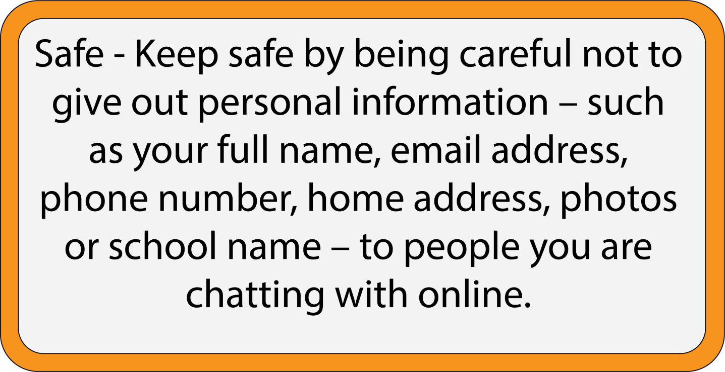

Slide 18
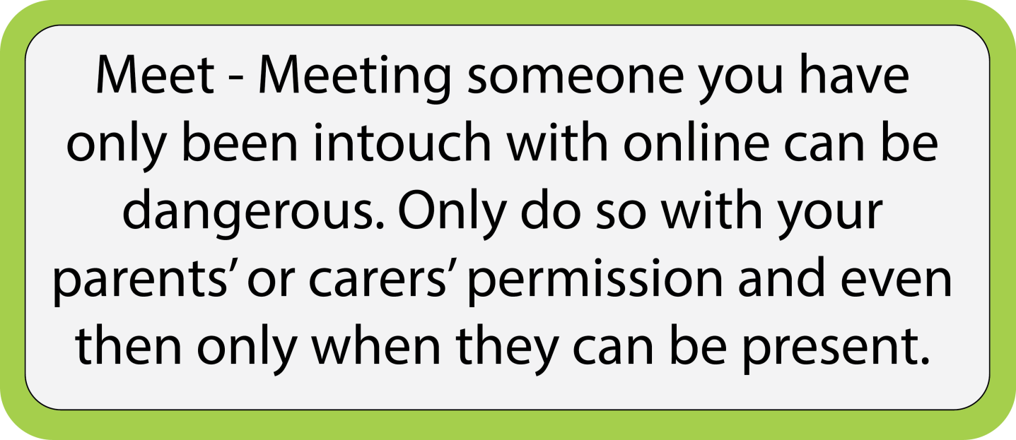

Slide 19
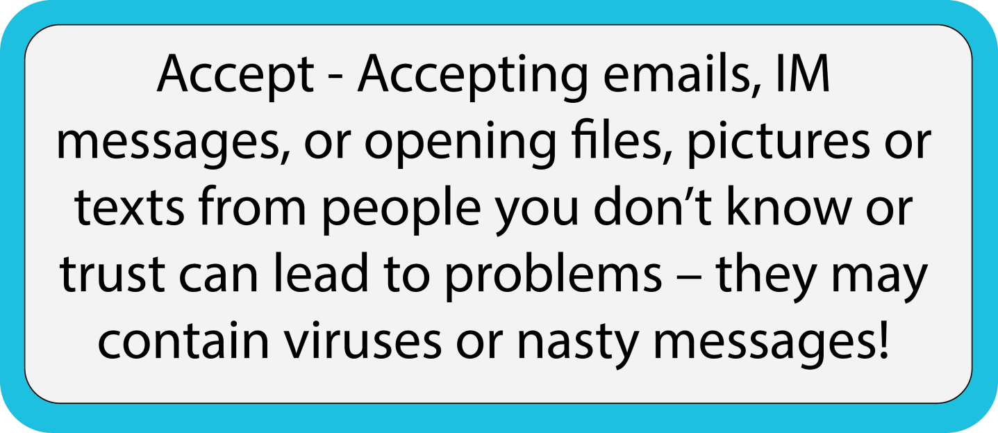

Slide 20
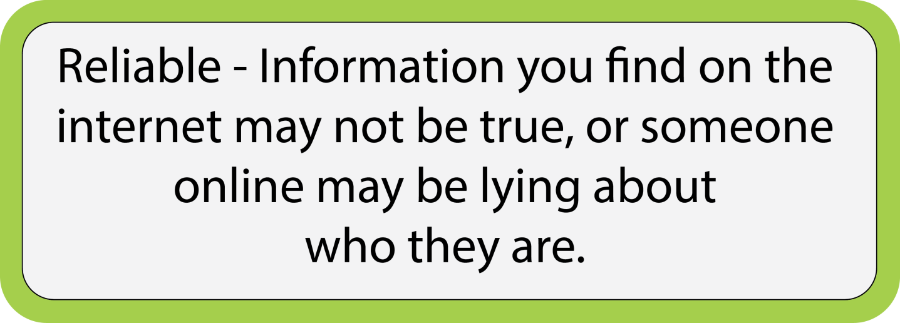

Slide 21
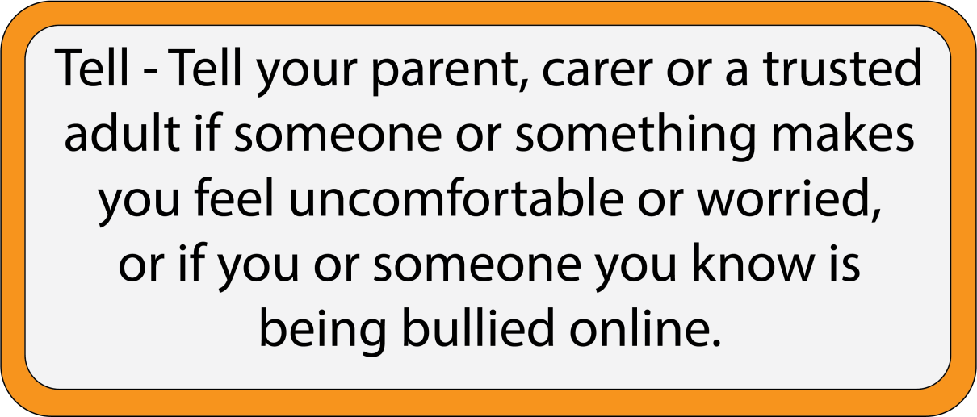

Slide 23
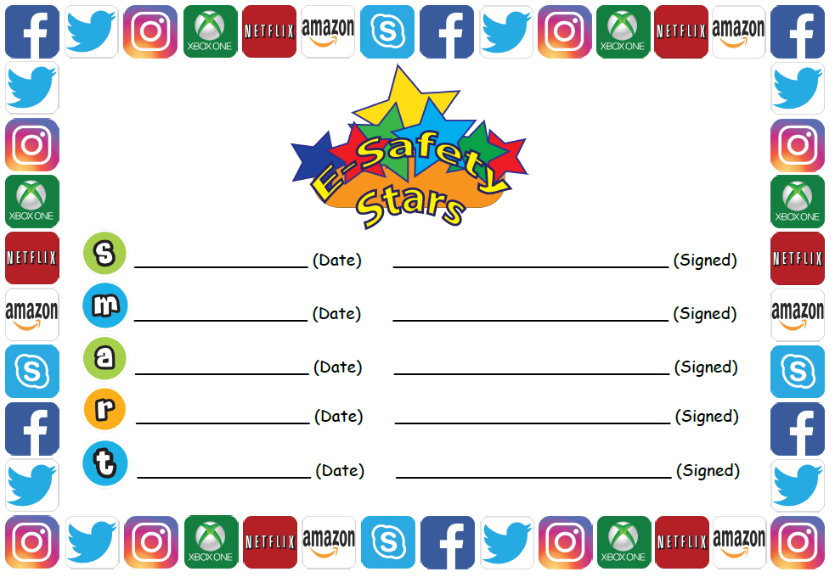

Slide 24
